Slide 1
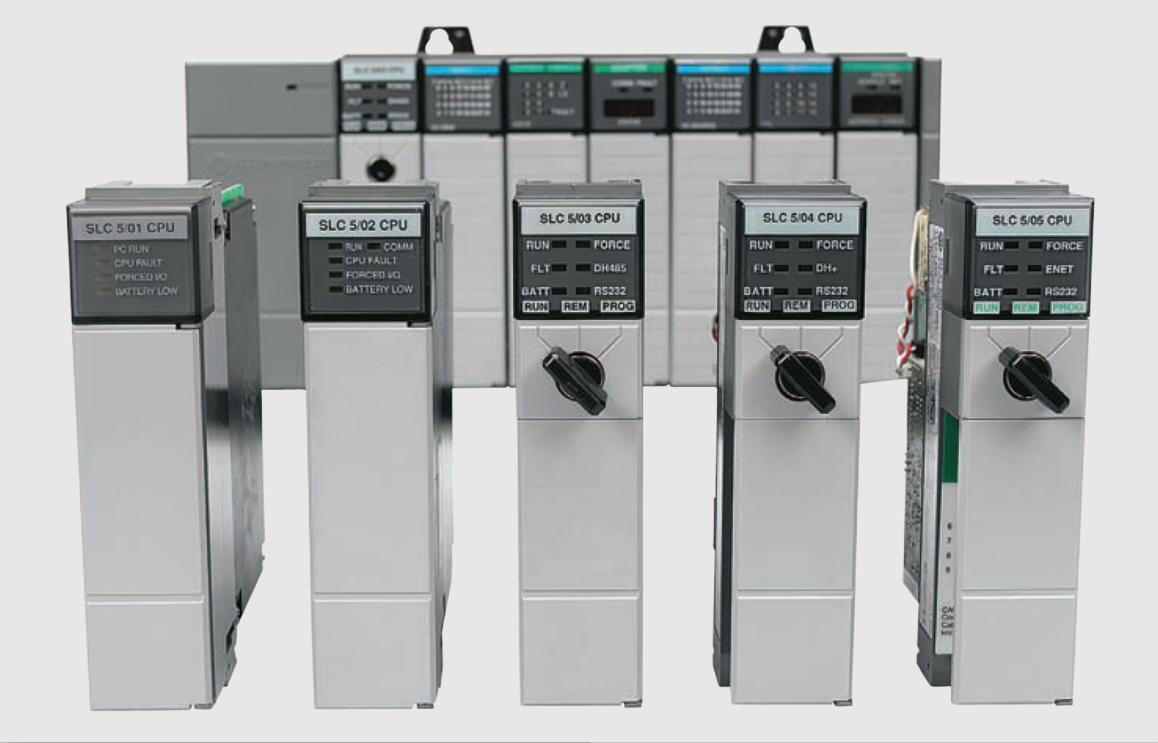
Developing Fundamental PLC Wiring Diagrams and Ladder Logic Programs

Slide 2
Electromagnetic Control Relays
An electrical relay is a magnetic switch. It uses electromagnetism to switch contacts.
A relay will usually have only one coil but may have any number of different contacts
Electromechanical control relay

Slide 3
Electromagnetic Control Relays
The coil and contacts are insulated from each other; therefore, under normal conditions, no electric circuit will exist between them
The letter M frequently indicates a motor starter, while CR is used for control relays
Normally open (NO) contacts are defined as those contacts that are open when no current flows through the coil but that close as soon as the coil conducts a current or is energized
Normally closed (NC) contacts are closed when the coil is de-energized and open when the coil is energized
Control relay coils and contacts have separate ratings. Coils are rated for the type of operating current (DC or AC) and normal operating voltage

Slide 4
Electromagnetic Control Relays
Relay operation

Slide 5
Electromagnetic Control Relays
Relay normally open and normally closed contacts

Slide 6
Contactors
A contactor is a special type of relay designed to handle heavy power loads that are beyond the capability of simple control relays
Unlike relays, contactors are designed to make and break higher powered circuits without being damaged
Such loads include lights, heaters, transformers, capacitors, and electric motors for which overload protection is provided separately or not required

Slide 7
Contactors
Three-pole magnetic contactor

Slide 8
Contactors
Contactor used in conjunction with a PLC output

Slide 9
Motor Starters
A motor starter is designed to provide power to motors
The motor starter is made up of a contactor with an overload relay attached physically and electrically
Motor starter is a contactor with an attached
overload relay

Slide 10
Motor Starters
The function of the overload relay can be summarized as follows:
Overload relays are designed to meet the special protective needs of motor control circuits
They allow harmless temporary overloads that occur when a motor starts
The overload relay will trip and disconnect power to the motor if an overload condition persists
Overload relays can be reset after the overload condition has been corrected

Slide 11
Motor Starters
Three-phase magnetic motor starter

Slide 12
Motor Starters
PLC control of a motor

Slide 13
Manually Operated Switches
Manually operated switches are controlled by hand such as toggle switches, pushbutton switches, knife switches, and selector switches.
Pushbutton switches are the most common form of manual control and can be divided as:
Normally open (NO) pushbutton , which makes a circuit when it is pressed
Normally closed (NC) pushbutton, which opens the circuit when it is pressed
Break-before-make pushbutton in which the top section contacts are NC and the bottom section contacts are NO. When the button is pressed, the top contacts open before the bottom contacts are closed

Slide 14
Manually Operated Switches
Commonly used types of pushbutton switches

Slide 15
Manually Operated Switches
The selector switch is another common manually operated switch
The main difference between a pushbutton and selector switch is the operator mechanism. A selector switch operator is rotated (instead of pushed) to open and close contacts of the attached contact block
Three-position selector switch

Slide 16
Manually Operated Switches
Dual in-line package (DIP) switches are small switch assemblies designed for mounting on printed circuit board modules
The pins or terminals on the bottom of the DIP switch are the same size and spacing as an integrated circuit (IC) chip
DIP switches use binary (on/off) settings to set the parameters for a particular module
DIP switch

Slide 17
Mechanically Operated Switches
A mechanically operated switch is controlled automatically by factors such as pressure, position, or temperature
The limit switch is a very common industrial control device. Limit switches are designed to operate only when a predetermined limit is reached, and they are usually actuated by contact with an object such as a cam
Mechanically operated limit switch

Slide 18
Mechanically Operated Switches
The temperature switch, or thermostat is used to sense temperature changes. Although there are many types available, they are all actuated by some specific environmental temperature change
Temperature switch

Slide 19
Mechanically Operated Switches
Pressure switches are used to control the pressure of liquids and gases. Although many different types are available, they are all basically designed to actuate (open or close) their contacts when a specified pressure is reached
Pressure switches can be pneumatically (air) or hydraulically (liquid) operated switches
Pressure switch

Slide 20
Mechanically Operated Switches
Level switches are used to sense liquid levels in vessels and provide automatic control for motors that transfer liquids from sumps or into tanks. They are also used to open or close piping solenoid valves to control fluids
Float type level switch

Slide 21
Sensors
Sensors are used for detecting, and often measuring, the magnitude of something
They convert mechanical, magnetic, thermal, optical, and chemical variations into electric voltages and currents
Sensors are usually categorized by what they measure, and they play an important role in modern manufacturing process control

Slide 22
Proximity Sensor
Proximity sensors or switches are devices that detect the presence of an object (usually called the target) without physical contact
These solid-state electronic devices are completely encapsulated to protect against excessive vibration, liquids, chemicals, and corrosive agents found in the industrial environment
Proximity sensor

Slide 23
Proximity Sensor
Proximity sensors are used when:
The object being detected is too small, lightweight, or soft to operate a mechanical switch
Rapid response and high switching rates are required, as in counting or ejection control applications
An object has to be sensed through nonmetallic barriers such as glass, plastic, and paper cartons
Unfriendly environments demand improved sealing properties, preventing proper operation of mechanical switches

Slide 24
Proximity Sensor
Proximity sensors are used when:
The object being detected is too small, lightweight, or soft to operate a mechanical switch
Rapid response and high switching rates are required, as in counting or ejection control applications
An object has to be sensed through nonmetallic barriers such as glass, plastic, and paper cartons
Unfriendly environments demand improved sealing properties, preventing proper operation of mechanical switches
Long life and reliable service are required
A fast electronic control system requires a bounce free input signal

Slide 25
Inductive proximity sensor
Inductive proximity sensors are used to detect both ferrous metals (containing iron) and nonferrous metals (such as copper, aluminum, and brass)
Inductive proximity sensors operate under the electrical principle of inductance, where a fluctuating current induces an electromotive force (emf) in a target object
Inductive proximity sensor

Slide 26
Inductive proximity sensor
The operation of inductive proximity sensor can be summarized as follows:
The oscillator circuit generates a high-frequency electromagnetic field that radiates from the end of the sensor
When a metal object enters the field, eddy currents are induced in the surface of the object
The eddy currents on the object absorb some of the radiated energy from the sensor, resulting in a loss of energy and change of strength of the oscillator
The sensor’s detection circuit monitors the oscillator’s strength and triggers a solid-state output at a specific level
Once the metal object leaves the sensing area, the oscillator returns to its initial value.

Slide 27
Inductive proximity sensor: wiring diagram
Typical three-wire DC sensor connection
Typical two-wire DC sensor connection

Slide 28
Inductive proximity sensor: sensing range
Hysteresis is the distance between the operating point when the target approaches the proximity sensor face and the release point when the target is moving away from the sensor face
Most proximity sensors come equipped with an LED status indicator to verify the output switching action
Proximity sensor sensing range

Slide 29
Capacitive proximity sensors
Capacitive proximity sensors are similar to inductive proximity sensors. The main differences between the two types are that capacitive proximity sensors produce an electrostatic field instead of an electromagnetic field and are actuated by both conductive and nonconductive materials
Capacitive proximity sensor

Slide 30
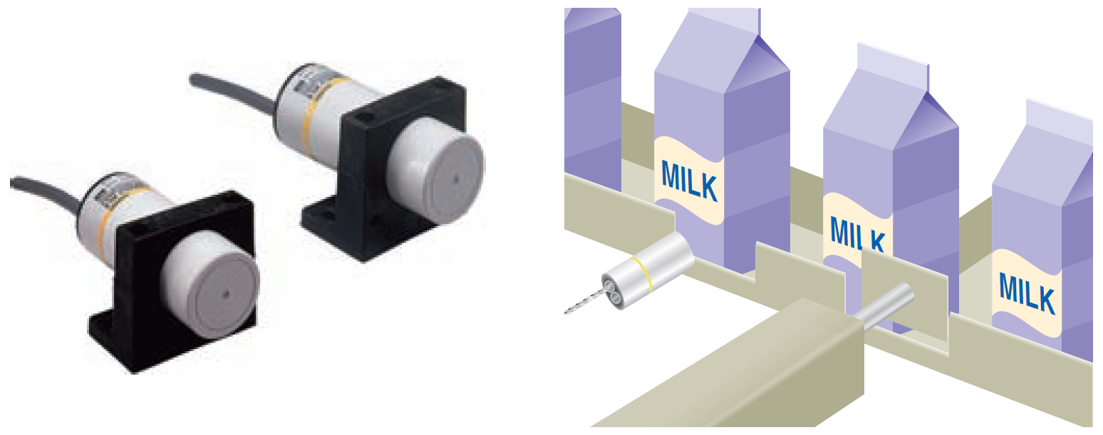
Capacitive proximity sensors
Capacitive proximity sensors will sense metal objects as well as nonmetallic materials such as paper, glass, liquids, and cloth
They typically have a short sensing range of about 1 inch regardless of type of material being sensed
The larger the dielectric constant of a target, the easier it is for the capacitive sensor to detect. This makes possible the detection of materials inside nonmetallic containers
Capacitive proximity
sensor liquid detection

Slide 31
Magnetic Reed Switch
A magnetic reed switch is composed of two flat contact tabs that are hermetically sealed (airtight) in a glass tube filled with protective gas
When a magnetic force is generated parallel to the reed switch, the reeds become flux carriers in the magnetic circuit. The overlapping ends of the reeds become opposite magnetic poles, which attract each other
Magnetic reed switch

Slide 32
Light Sensors
A photoelectric sensor is an optical control device that operates by detecting a visible or invisible beam of light and responding to a change in the received light intensity
Photoelectric sensors are composed of two basic components: a transmitter (light source) and a receiver (sensor)
Photoelectric sensor

Slide 33
Light Sensors
The scan technique refers to the method used by photoelectric sensors to detect an object
The through-beam scan technique (also called direct scan) places the transmitter and receiver in direct line with each other
Through-beam scan

Slide 34
Light Sensors
In a retroreflective scan, the transmitter and receiver are housed in the same enclosure
This arrangement requires the use of a separate reflector or reflective tape mounted across from the sensor to return light back to the receiver
Retroreflective scan

Slide 35
Light Sensors
Fiber optic sensors use a flexible cable containing tiny fibers that channel light from emitter to receiver
Fiber optic sensor systems are completely immune to all forms of electrical interference
Fiber optic sensors

Slide 36
Light Sensors
Bar code technology is widely implemented in industry to enter data quickly and accurately
A light source within the scanner illuminates the bar code symbol; those bars absorb light, and spaces reflect light
A photodetector collects this light in the form of an electronic-signal pattern representing the printed symbol.
PLC bar code application

Slide 37
Ultrasonic Sensors
An ultrasonic sensor operates by sending high-frequency sound waves toward the target and measuring the time it takes for the pulses to bounce back
The time taken for this echo to return to the sensor is directly proportional to the distance or height of the object because sound has a constant velocity
Ultrasonic sensor

Slide 38
Strain/Weight Sensors
A strain gauge converts a mechanical strain into an electric signal
Strain gauges are based on the principle that the resistance of a conductor varies with length and crosssectional area
The force applied to the gauge causes the gauge to bend which in turn changes its resistance
Strain gauge load cell

Slide 39
Temperature Sensors
The thermocouple is the most widely used temperature sensor
Thermocouples operate on the principle that when two dissimilar metals are joined, a predictable DC voltage will be generated that relates to the difference in temperature between the hot junction and the cold junction
The hot junction (measuring junction) is the joined end of a thermocouple that is exposed to the process where the temperature measurement is desired
The cold junction (reference junction) is the end of a thermocouple that is kept at a constant temperature to provide a reference point
Because of their ruggedness and wide temperature range, thermocouples are used in industry to monitor and control oven and furnace temperatures

Slide 40
Temperature Sensors
Thermocouple temperature sensor

Slide 41
Flow Measurement
Turbine-type flowmeters are a popular means of measurement and control of liquid products in industrial, chemical, and petroleum operations
Turbine flowmeters uses their angular velocity (rotation speed) to indicate the flow velocity
The bladed rotor rotates on its axis in proportion to the rate of the liquid flow through the tube
A magnetic pickup sensor is positioned as close to the rotor
Fluid passing through the flow tube causes the rotor to rotate, which generates pulses in the pickup coil
The frequency of the pulses is then transmitted to readout electronics

Slide 42
Flow Measurement
Turbine type flowmeter

Slide 43
Velocity and Position Sensors
Tachometer generators are converting rotational speed into an analog voltage signal that can be used for motor speed indication and control applications
A tachometer generator is a small AC or DC generator that develops an output voltage (proportional to its rpm) whose phase or polarity depends on the rotor’s direction of rotation
Tachometer generator feedback

Slide 44
Velocity and Position Sensors
An encoder is used to convert linear or rotary motion into a binary digital signal
The optical encoder uses a light source shining on an optical disk with lines or slots that interrupt the beam of light to an optical sensor
An electronic circuit counts the interruptions of the beam and generates the encoder’s digital output pulses
Optical encoder

Slide 45
Output Control Devices
A variety of output control devices can be operated by the PLC output to control traditional industrial processes
Symbols for output control devices

Slide 46
Output Control Devices
An actuator, in the electrical sense, is any device that converts an electrical signal into mechanical movement
An electromechanical solenoid is an actuator that uses electrical energy to magnetically cause mechanical control action. A solenoid consists of a coil, frame, and plunger
Solenoid construction
and operation

Slide 47
Output Control Devices
Solenoid valves are electromechanical devices that work by passing an electrical current through a solenoid, thereby changing the state of the valve
Normally, there is a mechanical element, which is often a spring, that holds the valve in its default position
A solenoid valve is a combination of a solenoid coil operator and valve, which controls the flow of liquids, gases, steam, and other media
When electrically energized, they open, shut off, or direct the flow of media

Slide 48
Output Control Devices
Solenoid valve construction and operation

Slide 49
Output Control Devices
Stepper motors operate differently than standard types of motor
The shaft of a stepper motor rotates in discrete increments (steps) when electrical command pulses are applied to it in the proper sequence
Every revolution is divided into a number of steps, and the amount of rotation is directly proportional to the number of pulses
A 1-degree-per-step motor will require 360 pulses to move through one revolution; the degrees per step are known as the resolution
Stepper systems are used most often in “open-loop” control systems, where the controller tells the motor only how many steps to move and how fast to move

Slide 50
Output Control Devices
Stepper motor/drive unit

Slide 51
Output Control Devices: open loop vs. closed loop
Most stepper motors operate in open-loop mode
Open loop is control without feedback, for example, when the controller tells the stepper motor how many steps to move and how fast to move, but does not verify where the motor is
Closed loop control compares speed or position feedback with the commanded speed or position and generates a modified command to make the error smaller
The error is the difference between the required speed or position and the actual speed or position

Slide 52
Output Control Devices: open loop vs. closed loop
Open- and closed-loop motor control systems

Slide 53
Output Control Devices: open loop vs. closed loop
Closed-loop servo motor system

Slide 54
Output Control Devices: Seal-In (Holding) Circuits
Seal-in, or holding, circuits are very common in both relay logic and PLC logic
Essentially, a seal-in circuit is a method of maintaining current flow after a momentary (pushbutton) switch has been pressed and released
In these types of circuits, the seal-in contact is usually in parallel with the momentary device
Motor seal-in circuit implemented using an PLC

Slide 55
Output Control Devices: Seal-In (Holding) Circuits
Hardwired and programmed seal-in circuit

Slide 56
Output Control Devices: Latching Relays
Electromagnetic latching relays are designed to hold the relay closed after power has been removed from the coil
Latching relays are used where it is necessary for contacts to stay open and/or closed even though the coil is energized only momentarily
The latch coil is momentarily energized to set the latch and hold the relay in the latched position
The unlatch or release coil is momentarily energized to disengage the mechanical latch and return the relay to the unlatched position

Slide 57
Output Control Devices: Latching Relays
Two-coil mechanical latching relay

Slide 58
Output Control Devices: Latching Relays
When the ON button is momentarily actuated, the latch coil is energized to set the relay to its latched position
The relay coil does not have to be continuously energized to hold the contacts closed and keep the light on
The only way to switch the lamp off is to actuate the OFF button, which will energize the unlatch coil and return the contacts to their open, unlatched state.
Hardwired control circuit for an
electromagnetic latching relay

Slide 59
Output Control Devices: Latching Relays
An electromagnetic latching relay function can be programmed on a PLC to work like its real-world counterparts
The S7-300 has two instruction: ---( S ) Set Coil and ---( R ) Reset coil for implemenation Latching Relay function
Both the latch (Set) and the unlatch (Reset) coil have the same address
Output latch and output unlatch operation

Slide 60
Converting Relay Schematics into PLC Ladder Programs
A sequential control process is required for processes that demand that certain operations be performed in a specific order
In a bottle filling process the filling and capping operations, the tasks are (1) fill bottle and (2) press on cap
These tasks must be performed in the proper order. Obviously we could not fill the bottle after the cap is pressed on. This process, therefore, requires sequential control.
Sequential control process

Slide 61
Converting Relay Schematics into PLC Ladder Programs
Combination controls require that certain operations be performed without regard to the order in which they are performed
An another part of the same bottle filling process. Here, the tasks are (1) place label 1 on bottle and (2) place label 2 on bottle. The order in which the tasks are performed does not really matter
Combination control process

Slide 62
Converting Relay Schematics into PLC Ladder Programs
Automatic control involves maintaining a desired set point at an output. One example is maintaining a certain set-point temperature in a furnace
If there is deviation from that set point, an error is determined by comparing the output against the set point and using this error to make a correction
Automatic control process

