Slide 1
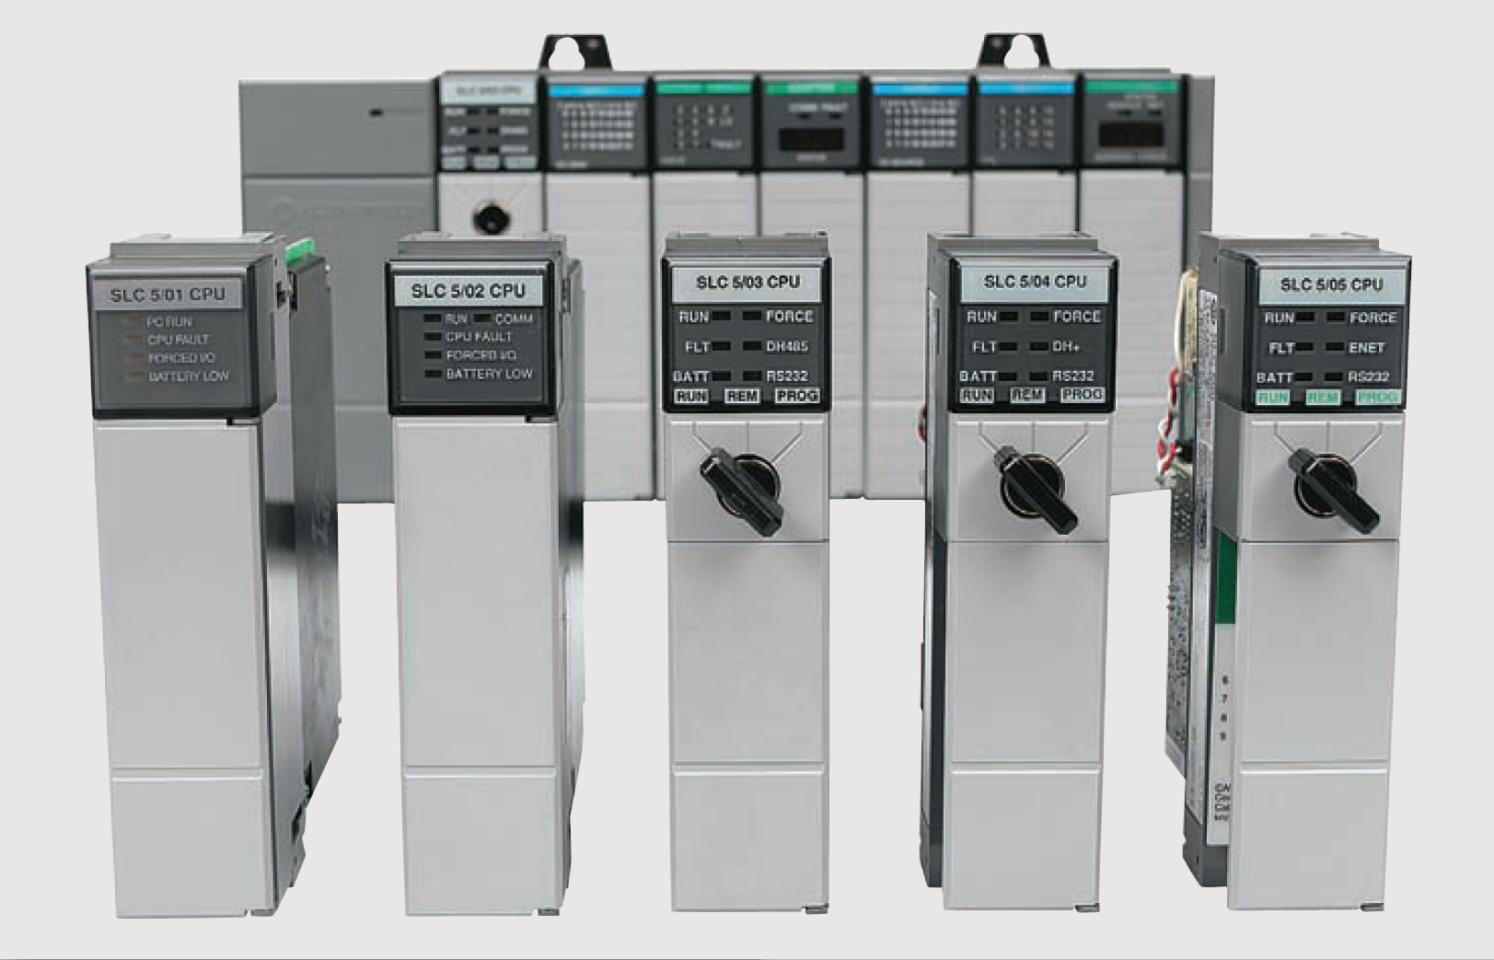
Data manipulation Instructions S7 300

Slide 2
Data Manipulation
Data manipulation instructions allow numerical data stored in the controller’s memory to be operated on within the control program
The use of data manipulation extends a controller’s capability from that of simple on/off control based on binary logic, to quantitative decision making involving data comparisons, arithmetic, and conversions—which in turn can be applied to analog and positioning control
There are two basic classes of instructions to accomplish data manipulation. Instructions that operate with:
Single word data
File, or block which involve multiple words

Slide 3
Data Manipulation
Each data manipulation instruction requires two or more words of data memory for operation
The words of data memory in singular form may be referred to either as registers or as words, depending on the manufacturer
The terms table or file are generally used when a consecutive group of related data memory words is referenced
Data files, words, and bits

Slide 4
Data Transfer Operations
Data transfer instructions simply involve the transfer of the contents from one word or register to another
Data transfer concept

Slide 5
Data Transfer Operations: MOVE Assign a Value
MOVE (Assign a Value) is activated by the Enable EN Input
The value specified at the IN input is copied to the address specified at the OUT output
ENO has the same logic state as EN
MOVE can copy only BYTE, WORD, or DWORD data objects
User-defined data types like arrays or structures have to be copied with the system function "BLKMOVE" (SFC 20)

Slide 6
Data Transfer Operations: MOVE Assign a Value
MOVE (Assign a Value) is activated by the Enable EN Input
The value specified at the IN input is copied to the address specified at the OUT output
ENO has the same logic state as EN
MOVE can copy only BYTE, WORD, or DWORD data objects
User-defined data types like arrays or structures have to be copied with the system function "BLKMOVE" (SFC 20)

Slide 7
Data Transfer Operations: MOVE Assign a Value
S7 300 block-formatted move instruction

Slide 8
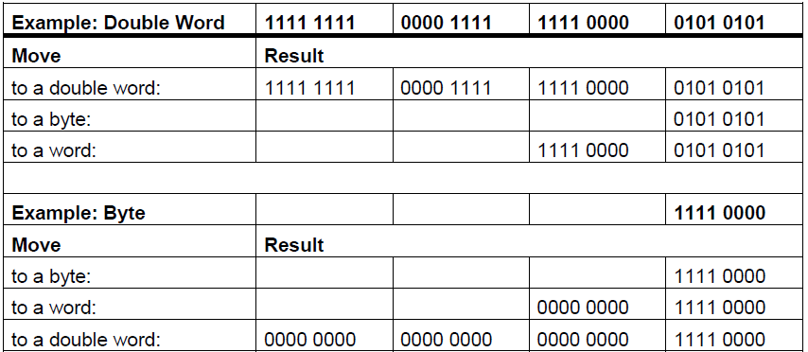
Data Transfer Operations: MOVE Assign a Value
When moving a value to a data type of a different length, higher-value bytes are truncated as necessary or filled up with zeros

Slide 9
Data Transfer Operations: MOVE with mask (MVM)
Some types of PLC have move with mask (MVM) instruction
The data being moved must pass through the mask to get to their destination values
Masking refers to the action of hiding a portion of a binary word before transferring it to the destination address
Masked move (MVM) instruction

