Slide 1
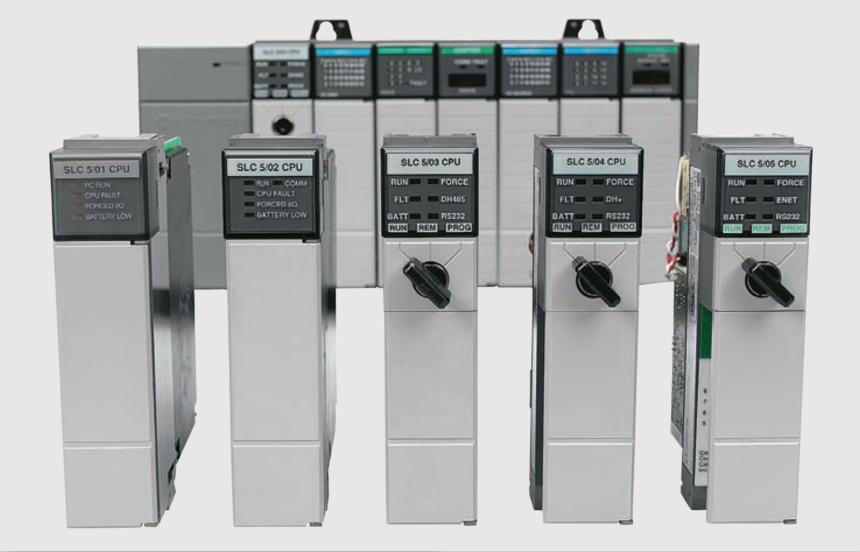
Counter Instruction S7 300

Slide 2
Mechanical counters
Mechanical counters can serve the same function as programmed counters
Every time the actuating lever is moved over, the counter adds one number; the actuating lever then returns automatically to its original position
Resetting to zero is done with a pushbutton located on the side of the unit
Mechanical counter

Slide 3
Electronic counters
Electronic counters can count up, count down, or be combined to count up and down
Although the majority of counters used in industry are up-counters, numerous applications require the implementation of down-counters or of combination up/ down-counters
Electronic counters

Slide 4
Electronic counters
All PLC manufacturers offer some form of counter instruction as part of their instruction set
One common counter application is keeping track of the number of items moving past a given point
Counter application

Slide 5
Counter Instructions
The following counter instructions are available:
S_CUD Up-Down Counter
S_CD Down Counter
S_CU Up Counter
---( SC ) Set Counter Coil
---( CU ) Up Counter Coil
---( CD ) Down Counter Coil

Slide 6
Location of a Counter in Memory
Counters have an area reserved for them in the memory of CPU
This memory area reserves one 16-bit word for each counter address
The ladder logic instruction set supports 256 counters
The counter instructions are the only functions that have access to the counter memory area

Slide 7
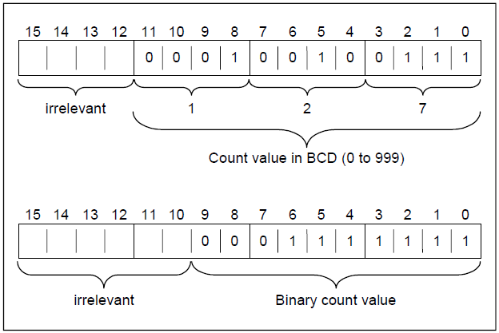
Setting count value
Bits 0 through 11 of the counter word contain the count value in binary code. The range of the count value is 0 to 999
A preset value should be entered in in the format: C#127

Slide 8
S_CUD Up-Down Counter
A positive edge transition at input S of the Up-Down Counter instruction sets the counter with the value at the Preset Value (PV) input
A signal state of 1 at input R resets the counter. Resetting the counter places the value of the count at 0
The counter is incremented by 1 if the signal state at input CU changes from 0 to 1 and the value of the counter is less than 999
The counter is decremented by 1 if the signal state at input CD changes from 0 to 1 and the value of the counter is more than 0
If there is a positive edge at both count inputs, both operations are executed and the count remains the same

Slide 9
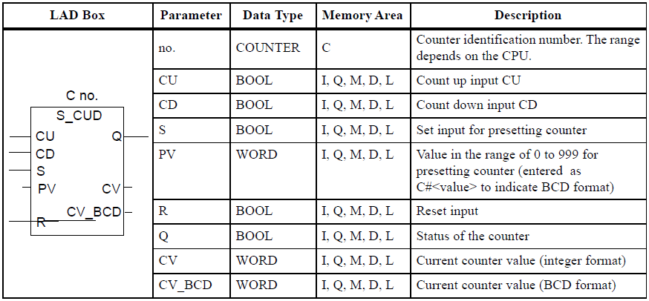
S_CUD Up-Down Counter

Slide 10
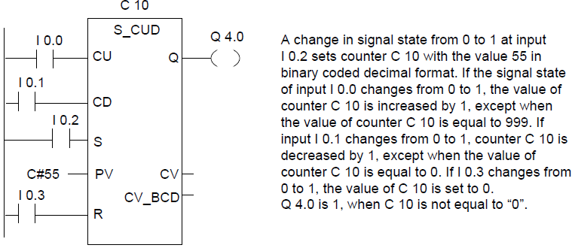
S_CUD Up-Down Counter: Example

Slide 11
S_CU Up Counter
A positive edge transition at input S of the Up Counter instruction sets the counter with the value at the Preset Value (PV) input
With a positive edge, the counter is reset at input R. The resetting of the counter sets the count value to 0
With a positive edge, the value of the counter at input CU is increased by 1 when the count value is less than 999
A signal state check for 1 at output Q produces a result of 1 when the count is greater than 0; the check produces a result of 0 when the count is equal to 0

Slide 12
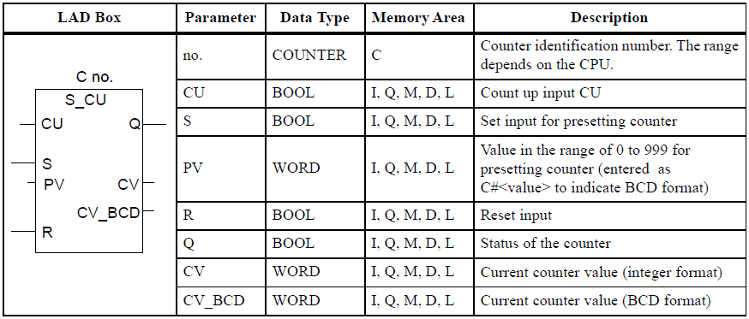
S_CU Up Counter

Slide 13
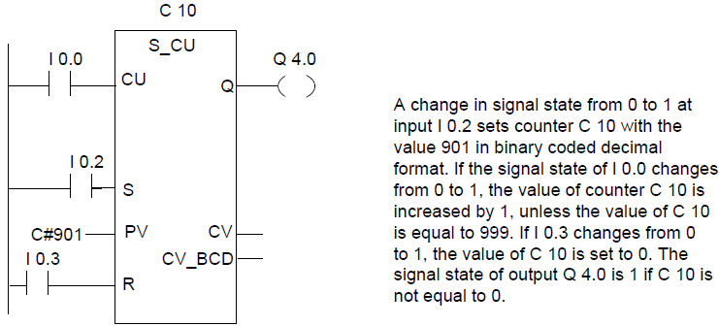
S_CU Up Counter: Example

Slide 14
S_CU Up Counter: Example
This control application is designed to turn the red pilot light on and the green pilot light off after an accumulated count of 7
Simple up-counter program

Slide 15
S_CU Up Counter: Example
Timing diagram

Slide 16
S_CU Up Counter: Example

Slide 17
S_CD Down Counter
A positive edge transition at input S of the Down Counter instruction sets the counter with the value at the Preset Value (PV) input
With a positive edge, the counter is reset at input R. The resetting of the counter sets the count value to 0
With a positive edge, the value of the counter at the input is reduced by 1 when the count value is greater than 0
A signal state check for 1 at output Q produces a result of 1 when the count is greater than 0; the check produces a result of 0 when the count is equal to 0

Slide 18
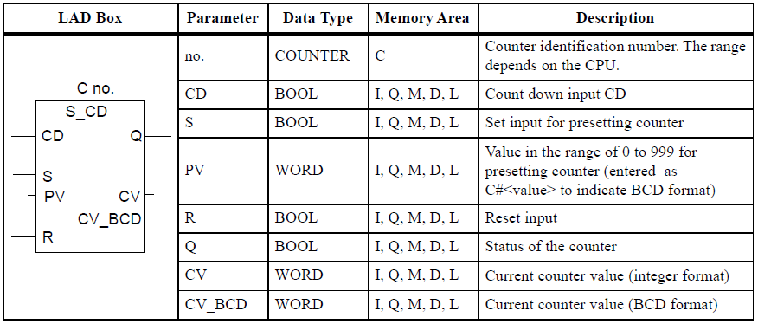
S_CD Down Counter

Slide 19
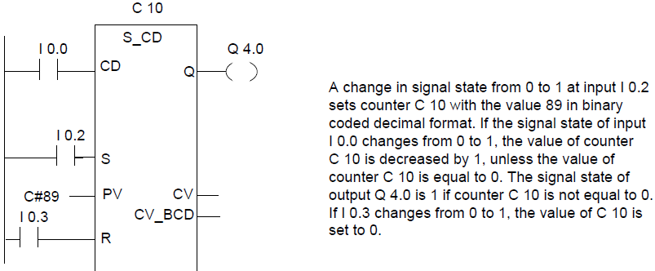
S_CD Down Counter

Slide 20
Counter instruction: ---( SC ) Set Counter Value
Set Counter Value executes only if there is a positive edge in RLO. At that time, the preset value transferred into the specified counter

Slide 21
Counter instruction: ---( CU ) Up Counter Coil
Up Counter Coil increments the value of the specified counter by one if there is a positive edge in the RLO and the value of the counter is less than "999“
If there is no positive edge in the RLO or the counter already has the value "999", the value of the counter will be unchanged

Slide 22
Counter instruction: ---( CD ) Down Counter Coil
Down Counter Coil decrements the value of the specified counter by one, if there is a positive edge in the RLO state and the value of the counter is more than "0“
If there is no positive edge in the RLO or the counter has already the value "0", the value of the counter will be unchanged

