Slide 1
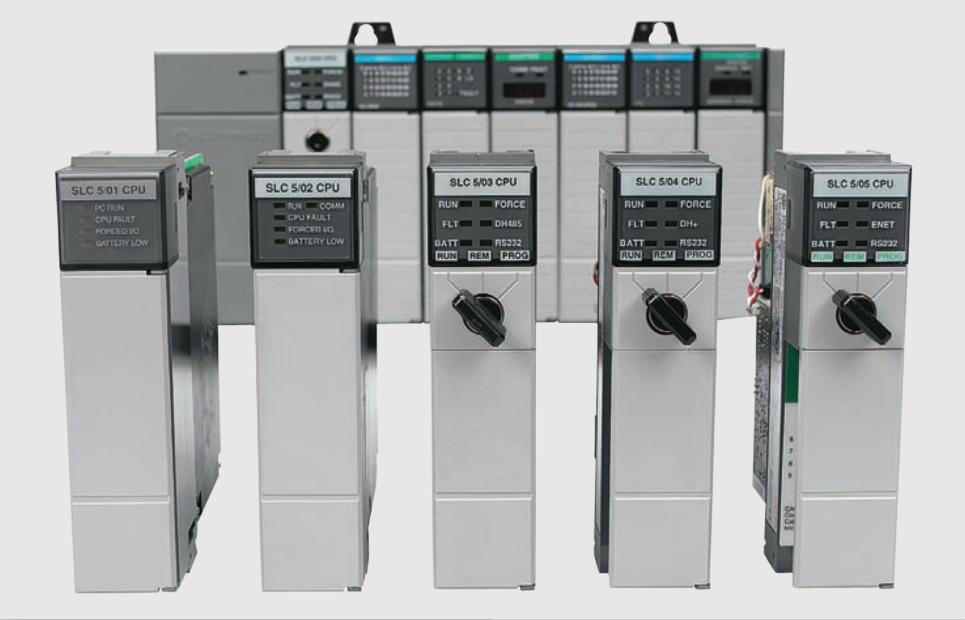
Ladder programming Timer Instruction S7 300

Slide 2
Mechanical Timing Relays
Mechanical timing relays are used to delay the opening or closing of contacts for circuit control
The operation of a mechanical timing relay is similar to that of a control relay, except that certain of its contacts are designed to operate at a preset time interval, after the coil is energized or de-energized
Mechanical timing relays provide time delay through two arrangements:
The first arrangement, on delay, provides time delay when the relay coil is energized
The second arrangement, off delay, provides time delay when the relay coil is de-energized

Slide 3
Mechanical Timing Relays
Mechanical Timing relays
Pneumatic on-delay timer

Slide 4
Timing Relays: symbols
Timed contact symbols

Slide 5
Timer Instructions
The following timer instructions are available:
S_PULSE Pulse S5 Timer
S_PEXT Extended Pulse S5 Timer
S_ODT On-Delay S5 Timer
S_ODTS Retentive On-Delay S5 Timer
S_OFFDT Off-Delay S5 Timer
---( SP ) Pulse Timer Coil
---( SE ) Extended Pulse Timer Coil
---( SD ) On-Delay Timer Coil
---( SS ) Retentive On-Delay Timer Coil
---( SA ) Off-Delay Timer Coil

Slide 6
Location of a Timer in Memory
Timers have an area reserved for them in the memory of CPU
This memory area reserves one 16-bit word for each timer address
The ladder logic instruction set supports 256 timers

Slide 7
Setting time value
Bits 0 through 11 of the timer word contain the time value in binary code
The time range is from 0 to 9,990 seconds.
A time value can be loaded into the timer word in binary, hexadecimal, or binary coded decimal (BCD) format:
W#16#wxyz
Where w = the time base (that is, the time interval or resolution)
Where xyz = the time value in binary coded decimal format
S5T#aH_bM_cS_dMS
Where H = hours, M = minutes, S = seconds, and MS = milliseconds;
a, b, c, d are defined by the user

Slide 8
Time base
Bits 12 and 13 of the timer word contain the time base in binary code
The time base defines the interval at which the time value is decremented by one unit
The smallest time base is 10 ms; the largest is 10 s.

Slide 9
Timer resolution
Depending of chosen time base different time resolution can be obtained
General rule is smaller time base better resolution and vice versa

Slide 10
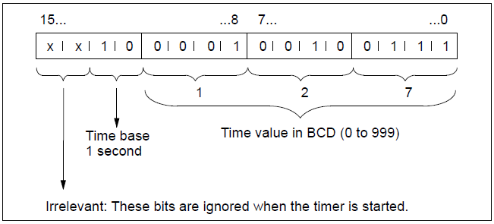
Timer word
Bits 0 through 11 of the timer cell hold the time value in binary coded decimal format (BCD format: each set of four bits contains the binary code for one decimal value)
Bits 12 and 13 hold the time base in binary code

Slide 11
Reading the Time and the Time Base
Each timer box provides two outputs, BI and BCD, for which we can indicate a word location
The BI output provides the time value in binary format
The BCD output provides the time base and the time value in binary coded decimal (BCD) format.

Slide 12
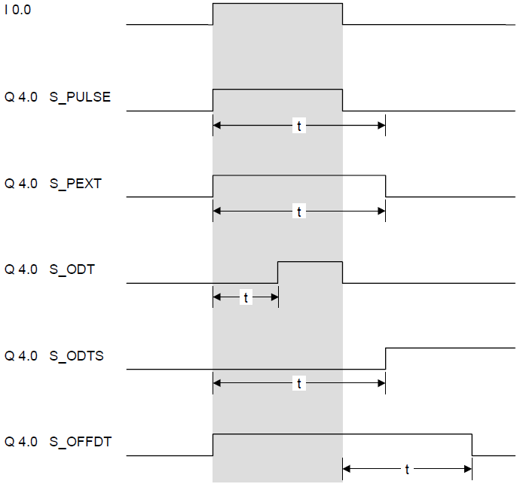
Choosing the Right Timer

Slide 13
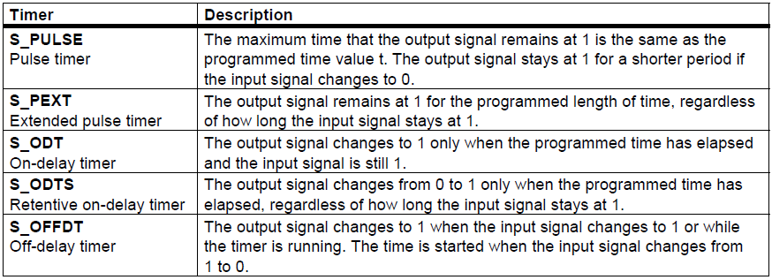
Choosing the Right Timer

Slide 14
S_PULSE Pulse S5 Timer
S_PULSE (Pulse S5 Timer) starts the specified timer if there is a positive edge at the start (S) input. A signal change is always necessary in order to enable a timer
The timer continues to run with the specified time at the Time Value (TV) input until the programmed time elapses, as long as the signal state at input TV is 1
The signal state at output Q is "1“ as long as the timer is running
If there is a change from "1" to "0" at the S input before the time interval has elapsed the timer will be stopped.
The timer is reset when the timer reset (R) input changes from "0" to "1" while the timer is running.

Slide 15
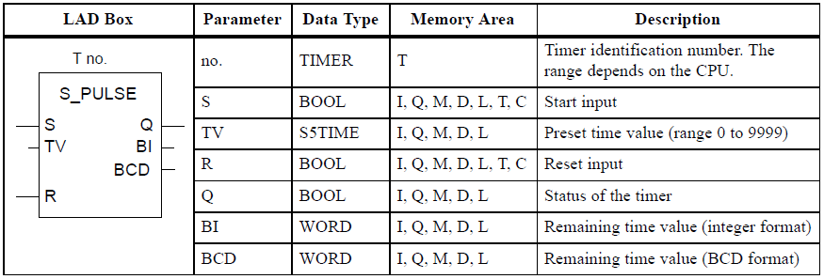
S_PULSE Pulse S5 Timer

Slide 16
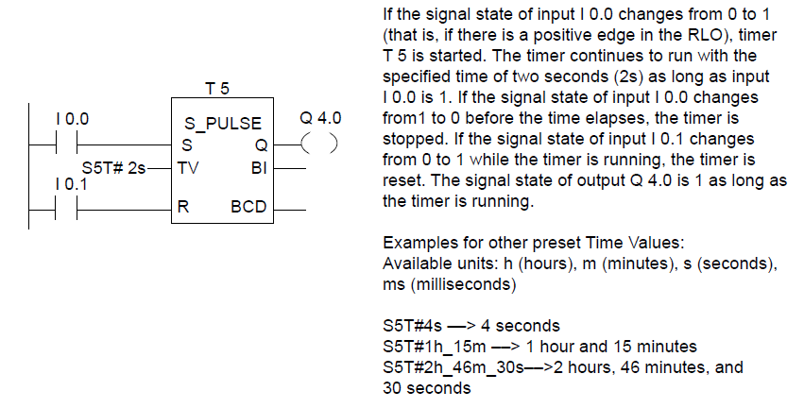
S_PULSE Pulse S5 Timer: Example

Slide 17
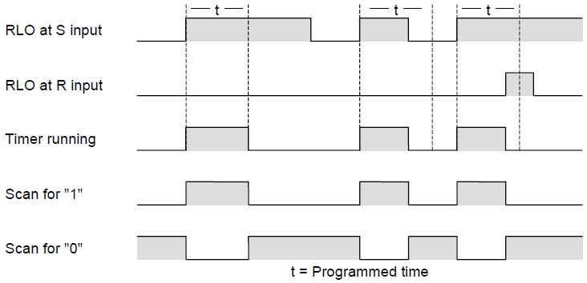
S_PULSE Pulse S5 Timer: Example

Slide 18
Extended Pulse S5 Timer
The Extended Pulse S5 Timer instruction starts a specified timer if there is a positive edge transition on Start (S) input
The timer continues to run with the specified time at the Time Value (TV) input, even if the signal state at the S input changes to 0 before the time has elapsed
The signal state at output Q is "1" as long as the timer is running
The timer will be restarted ("re-triggered") with the preset time value if the signal state at input S changes from "0" to "1" while the timer is running
The timer is reset if the reset (R) input changes from "0" to "1" while the timer is running. The current time and the time base are set to zero.

Slide 19
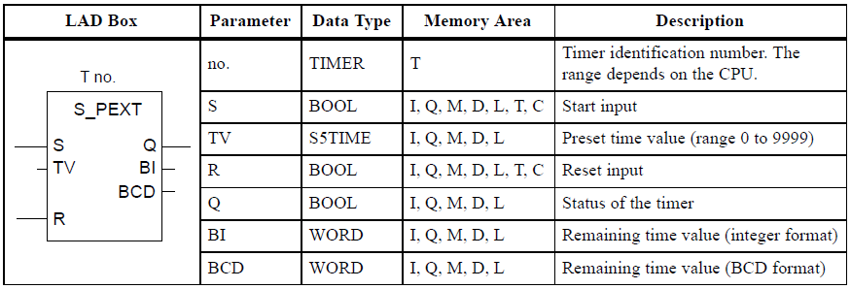
Extended Pulse S5 Timer

Slide 20
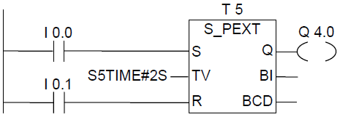
Extended Pulse S5 Timer: Example
If the signal state of input I0.0 changes from "0" to "1" (positive edge in RLO), the timer T5 will be started.
The timer will continue to run for the specified time of two seconds (2 s) without being affected by a negative edge at input S
If the signal state of I0.0 changes from "0" to "1" before the timer has expired the timer will be re-triggered
The output Q4.0 is logic "1" as long as the timer is running.

Slide 21
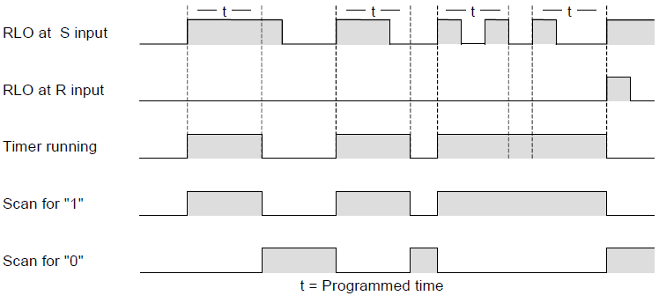
Extended Pulse S5 Timer: Example

Slide 22
S_ODT On-Delay S5 Timer
The On-Delay S5 Timer instruction starts a specified timer if there is a positive edge transition at the Start (S) input
The timer continues to run with the specified time at the Time Value (TV) input as long as the signal state at input S is 1
The signal state at output Q is "1" when the timer has elapsed without error and the signal state at the S input is still "1“
When the signal state at input S changes from "1" to "0" while the timer is running, the timer is stopped. In this case the signal state of output Q is "0".
The timer is reset if the reset (R) input changes from "0" to "1" while the timer is running
The timer is also reset if there is a logic "1" at the R input while the timer is not running and the RLO at input S is "1".

Slide 23
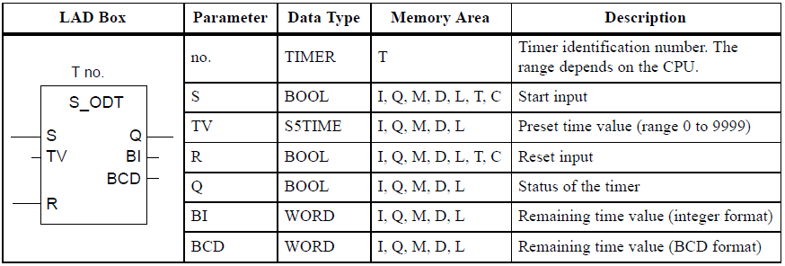
S_ODT On-Delay S5 Timer

Slide 24
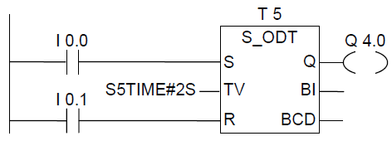
S_ODT On-Delay S5 Timer: Example
If the signal state of I0.0 changes from "0" to "1" (positive edge in RLO), the timer T5 will be started
If the time of two seconds elapses and the signal state at input I0.0 is still "1", the output Q4.0 will be "1“
If the signal state of I0.0 changes from "1" to "0", the timer is stopped and Q4.0 will be "0" (if the signal state of I0.1 changes from "0" to "1", the time is reset regardless of whether the timer is running or not)

Slide 25
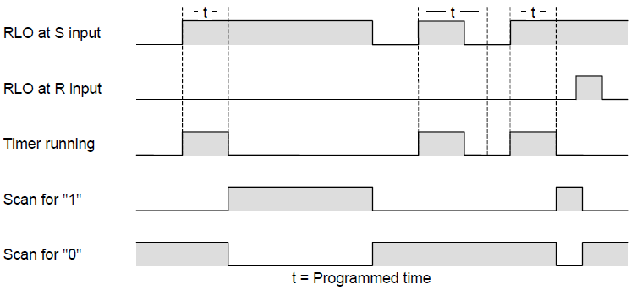
S_ODT On-Delay S5 Timer: Example

Slide 26
S_ODTS Retentive On-Delay S5 Timer
The Retentive On-Delay S5 Timer instruction starts a specified timer if there is a positive edge transition at the Start (S) input
The timer continues to run with the time that is specified at the Time Value (TV) input, even if the signal state at input S changes to 0 before the timer has expired
The signal state at output Q is "1" when the timer has elapsed without regard to the signal state at input S
The timer will be restarted (re-triggered) with the specified time if the signal state at input S changes from "0" to "1" while the timer is running
The timer is reset if the reset (R) input changes from "0" to "1" without regard to the RLO at the S input. The signal state at output Q is then "0"

Slide 27
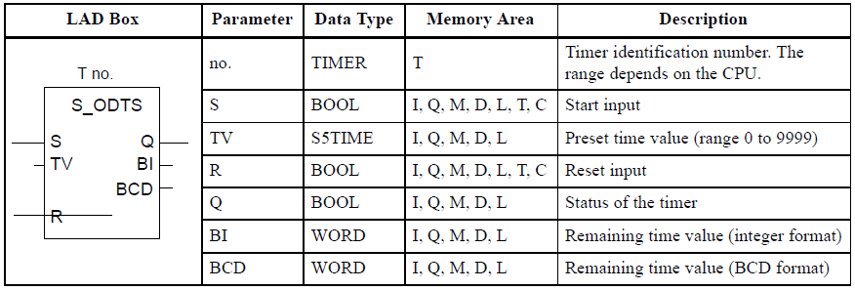
S_ODTS Retentive On-Delay S5 Timer

Slide 28
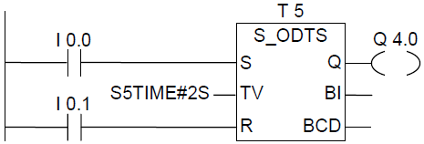
S_ODTS Retentive On-Delay S5 Timer: Example
If the signal state of I0.0 changes from "0" to "1" (positive edge in RLO), the timer T5 will be started. The timer runs without regard to a signal change at I0.0 from "1“ to "0“
If the signal state at I0.0 changes from "0" to "1" before the timer has expired, the timer will be re-triggered
The output Q4.0 will be "1" if the timer elapsed. (If the signal state of input I0.1 changes from "0" to "1", the time will be reset irrespective of the RLO at S.)

Slide 29
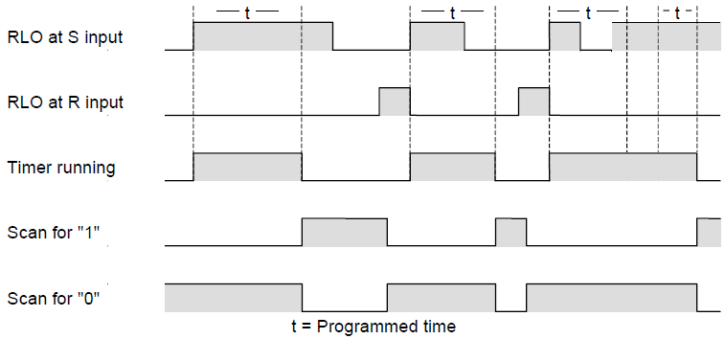
S_ODTS Retentive On-Delay S5 Timer: Example

Slide 30
S_OFFDT Off-Delay S5 Timer
The Off-Delay S5 Timer instruction starts a specified timer if there is a negative edge transition at the Start (S) input
The signal state at output Q is "1" if the signal state at the S input is "1" or while the timer is running.
The timer is reset when the signal state at input S goes from "0" to "1" while the timer is running
The timer is not restarted until the signal state at input S changes again from "1" to "0"
The timer is reset when the reset (R) input changes from "0" to "1" while the timer is running

Slide 31
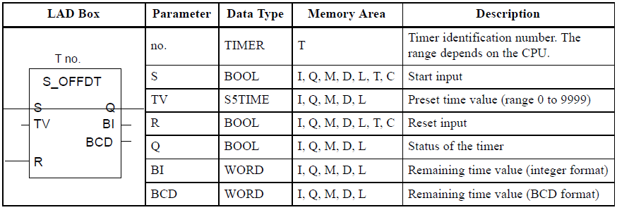
S_OFFDT Off-Delay S5 Timer

Slide 32
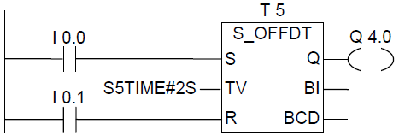
S_OFFDT Off-Delay S5 Timer: Example
If the signal state of I0.0 changes from "1" to "0", the timer is started
Q4.0 is "1" when I0.0 is "1" or the timer is running. (if the signal state at I0.1 changes from "0" to "1" while the time is running, the timer is reset)

Slide 33
S_OFFDT Off-Delay S5 Timer: Example
If the signal state of I0.0 changes from "1" to "0", the timer is started
Q4.0 is "1" when I0.0 is "1" or the timer is running. (if the signal state at I0.1 changes from "0" to "1" while the time is running, the timer is reset)

Slide 34
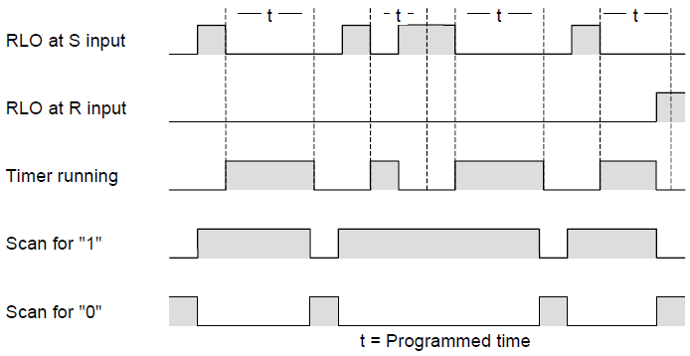
S_OFFDT Off-Delay S5 Timer: Example

Slide 35
Timer instruction: ---( SP ) Pulse Timer Coil
Pulse Timer Coil starts the specified timer with the <time value> when there is a positive edge on the RLO state
The timer continues to run for the specified time interval as long as the RLO remains positive ("1")
The signal state of the counter is ”1” as long as the timer is running
If there is a change from "1" to "0" in the RLO before the time value has elapsed, the timer will stop.
In this case, a scan for "1" always produces the result "0".

Slide 36
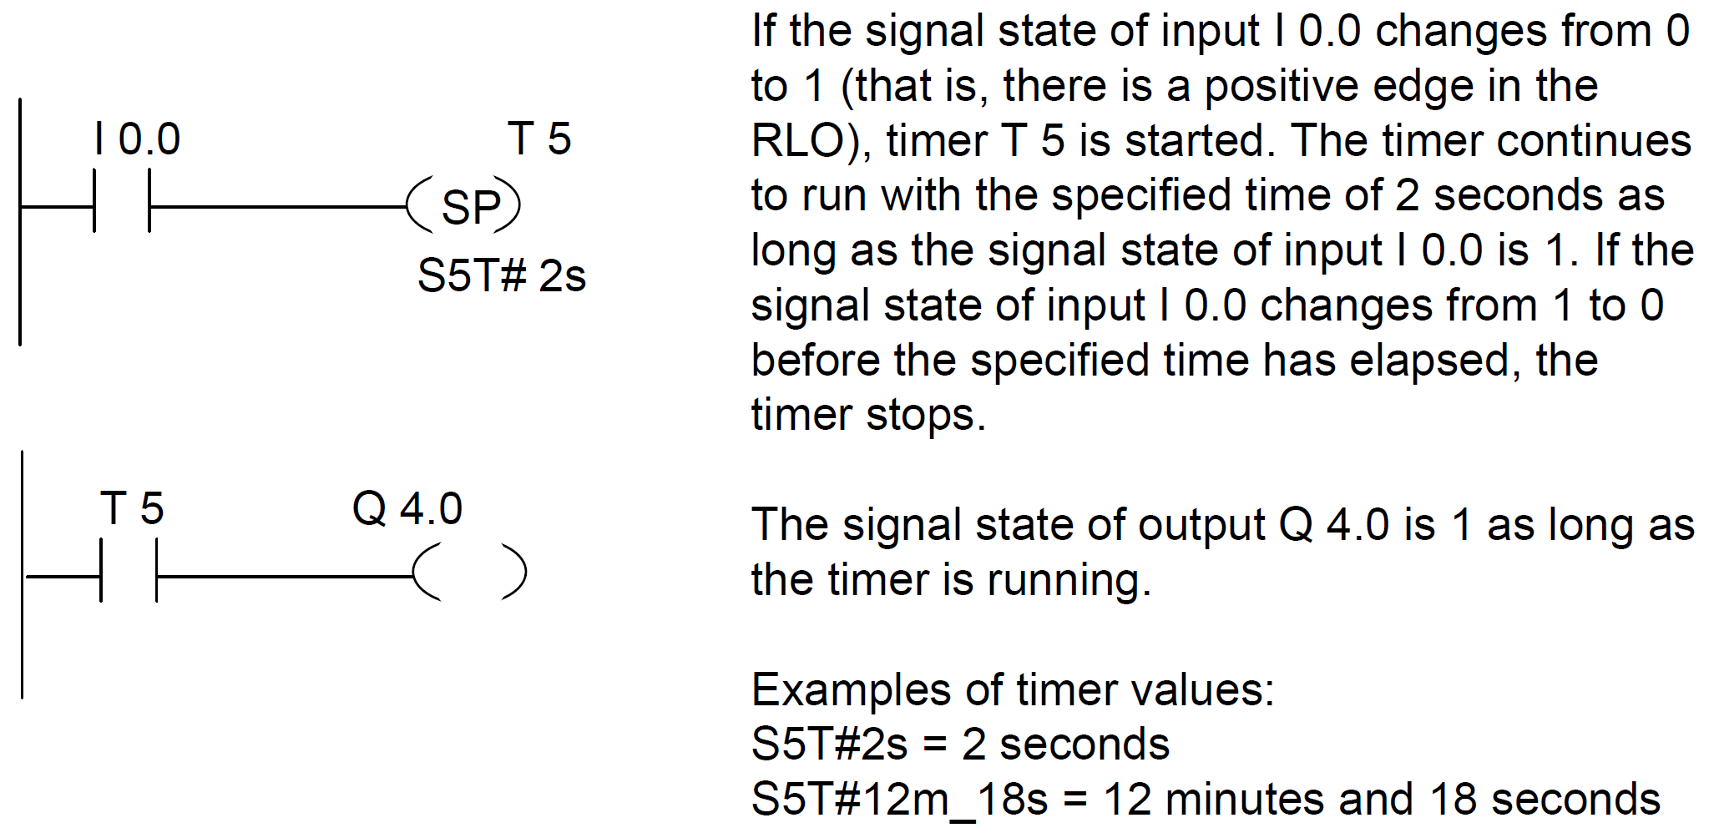
Timer instruction: ---( SP ) Pulse Timer Coil: Example

Slide 37
Timer instruction: ---( SE ) Extended Pulse Timer Coil
Extended Pulse Timer Coil starts the specified timer with the specified <time value> when there is a positive edge on the RLO state
The timer continues to run for the specified time interval even if the RLO changes to "0" before the timer has expired
The signal state of the counter is ”1” as long as the timer is running.
The timer will be restarted (re-triggered) with the specified time value if the RLO changes from "0" to "1" while the timer is running

Slide 38
Timer instruction: ---( SE ) Extended Pulse Timer Coil

Slide 39
Timer instruction: ---( SD ) On-Delay Timer Coil
On Delay Timer Coil starts the specified timer with the <time value> if there is a positive edge on the RLO state
The signal state of the timer is "1" when the <time value> has elapsed without error and the RLO is still "1“
When the RLO changes from "1" to "0" while the timer is running, the timer is reset. In this case, a scan for "1" always produces the result "0".

Slide 40
Timer instruction: ---( SD ) On-Delay Timer Coil: Example

Slide 41
Timer instruction: ---( SS ) Retentive On-Delay Timer Coil
Retentive On-Delay Timer Coil starts the specified timer if there is a positive edge on the RLO state
The signal state of the timer is "1" if the time value has elapsed
A restart of the timer is only possible if it is reset explicitly. Only a reset causes the signal state of the timer to be set to "0"
The timer restarts with the specified time value if the RLO changes from "0" to "1“ while the timer is running

Slide 42
Timer instruction: ---( SS ) Retentive On-Delay Timer Coil

Slide 43
Timer instruction: ---( SF ) Off-Delay Timer Coil
Off-Delay Timer Coil starts the specified timer if there is a negative edge on the RLO state
The timer is "1" when the RLO is "1" or as long as the timer is running during the <time value> interval
The timer is reset when the RLO goes from "0" to "1" while the timer is running
The timer is always restarted when the RLO changes from "1" to "0"

Slide 44
Timer instruction: ---( SF ) Off-Delay Timer Coil

