Slide 1
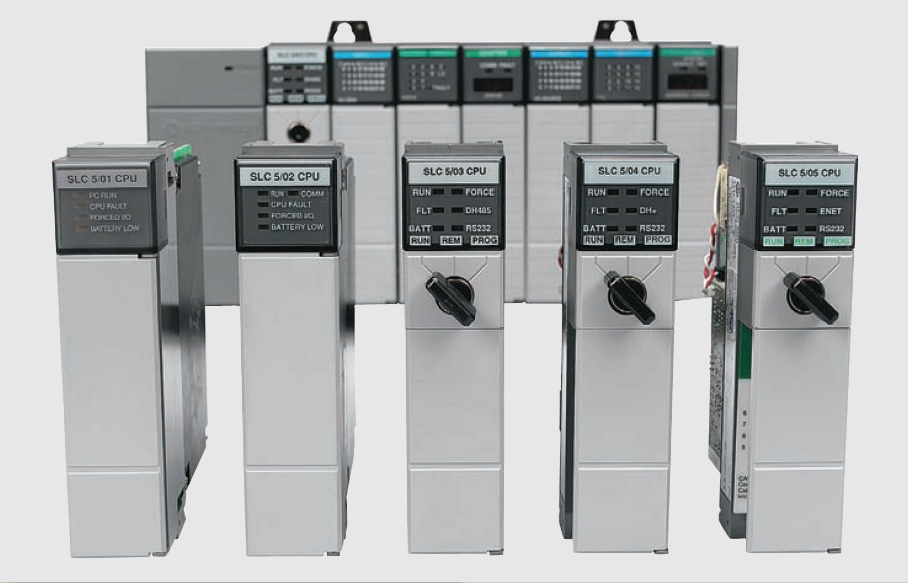
Ladder programming bit logic Instruction

Slide 2
PLC Programming Languages: Structured Text
Structured text is a high level text language primarily used to implement complex procedures that cannot be easily expressed with graphical languages
PLC ladder and equivalent structured text
program

Slide 3
Bit Logic Instructions: ---| |--- Normally Open Contact
Is closed when the bit value stored at the PII is equal to "1". When the contact is closed, ladder rail power flows across the contact and the result of logic operation (RLO) = "1”
Otherwise, if the signal state at the PII is "0", the contact is open. When the contact is opened, power does not flow across the contact and the result of logic operation (RLO) = "0"
Examine If Closed instruction

Slide 4
Bit Logic Instructions: ---| / |--- Normally Closed Contact
Is closed when the bit value stored at the PII is equal to “0". When the contact is closed, ladder rail power flows across the contact and the result of logic operation (RLO) = "1”
Otherwise, if the signal state at the PII is “1", the contact is open. When the contact is opened, power does not flow across the contact and the result of logic operation (RLO) = "0"
Examine If Opened instruction

Slide 5
Bit Logic Instructions: ---( ) Output Coil
This instruction looks and operates like a relay coil and is associated with a POI memory bit. This instruction signals the PLC to energize (switch on) or de-energize (switch off ) the output
Output Coil energize instruction

Slide 6
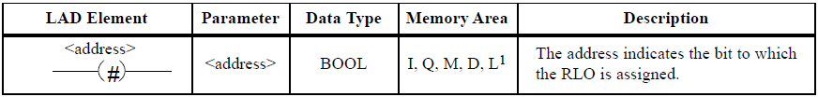
Bit Logic Instructions: Midline Output
The Midline Output instruction is an intermediate assigning element that stores the RLO
This intermediate assigning element saves the bit logic combination of the last open branch until the assigning element is reached
In a series with other contacts, the Midline Output functions as a normal contact

Slide 7
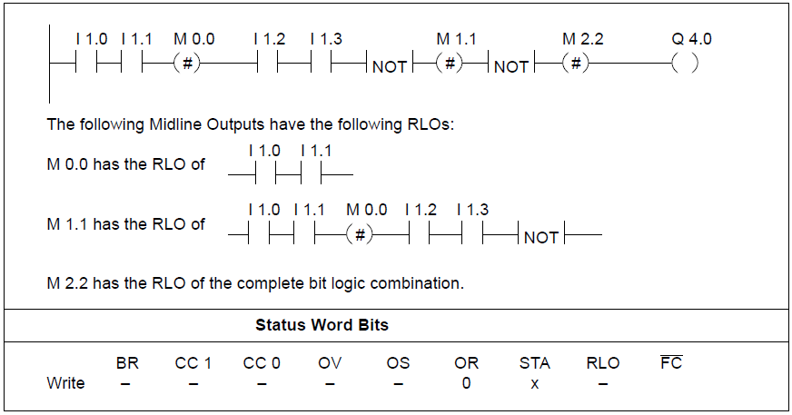
Bit Logic Instructions: Midline Output

Slide 8
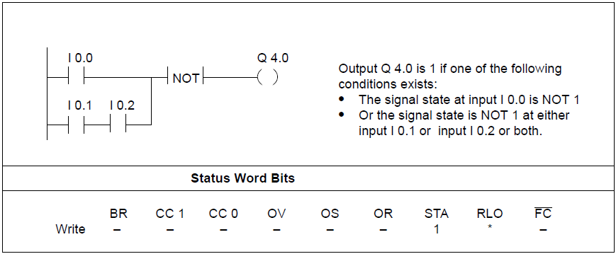
Bit Logic Instructions: Invert Power Flow
The Invert Power Flow instruction negates the RLO

Slide 9

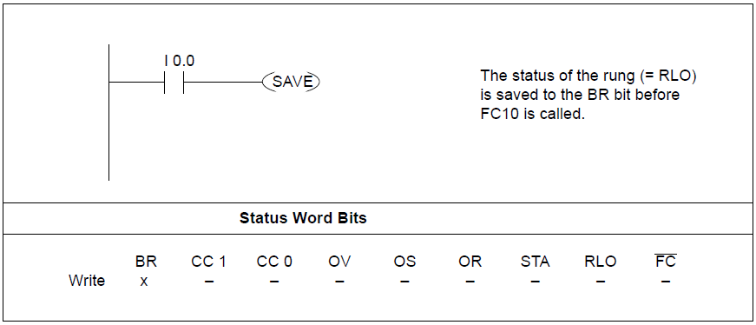
Bit Logic Instructions: Save RLO to BR Memory
The Save RLO to BR Memory instruction saves the RLO to the BR bit of the status word

Slide 10
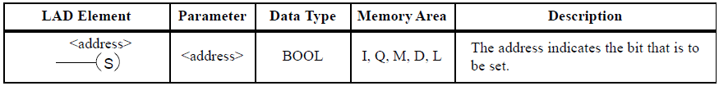
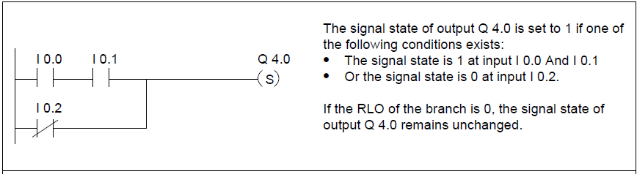
Bit Logic Instructions: Set Coil
The Set Coil instruction is executed only if the RLO = 1
If the RLO = 1, this instruction sets its specified address to 1
If the RLO = 0, the instruction has no effect on the specified address

Slide 11
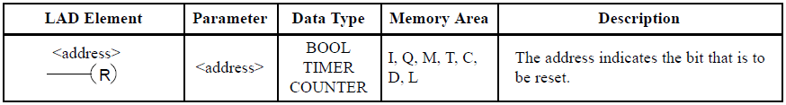
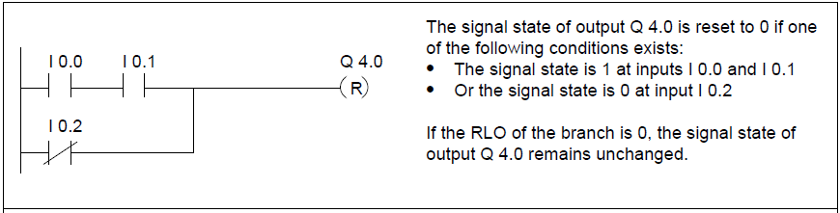
Bit Logic Instructions: Reset Coil
The Reset Coil instruction is executed only if the RLO = 1.
If the RLO = 1, this instruction resets its specified address to 0
If the RLO = 0, the instruction has no effect on its specified address.

Slide 12
Bit Logic Instructions: Set Reset Flipflop
The Set Reset Flipflop instruction executes Set (S) and Reset (R) operations only when the RLO is 1
An RLO of 0 has no effect on these operations; the address specified in the operation remains unchanged
A Set Reset Flipflop is set if the signal state is 1 at the S input and 0 at the R input
Otherwise, if the signal state is 0 at the S input and 1 at the R input, the Flipflop is reset
If the RLO is 1 at both inputs the SR flip flop executes first the Set instruction then the Reset instruction at the specified <address>, so that this address remains reset for the remainder of program scanning

Slide 13
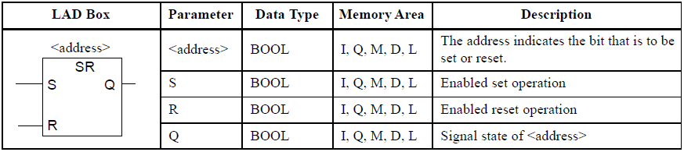
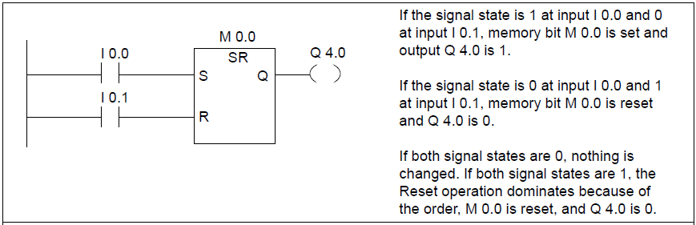
Bit Logic Instructions: Set Reset Flipflop

Slide 14
Bit Logic Instructions: Reset Set Flipflop
The Reset Set Flipflop instruction executes Set (S) and Reset (R) operations only when the RLO is 1. An RLO of 0 has no effect on these operations; the address specified in the operation remains unchanged
A Reset Set Flipflop is reset if the signal state is 1 at the R input and 0 on the S input
Otherwise, if the signal state is 0 at the R input and 1 at the S input, the Flipflop is set
If the RLO is 1 at both inputs, the RS flip flop executes first the Reset instruction then the Set instruction at the specified <address>, so that this address remains set for the remainder of program scanning

Slide 15
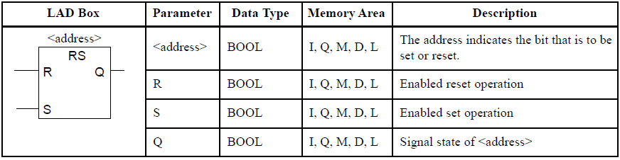
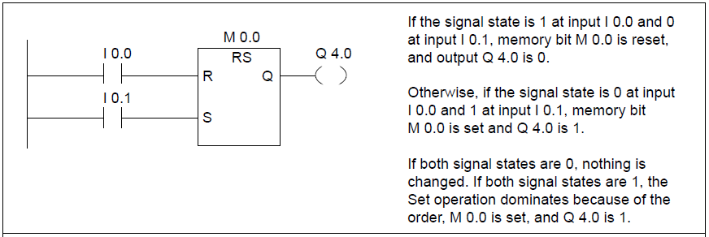
Bit Logic Instructions: Reset Set Flipflop

Slide 16
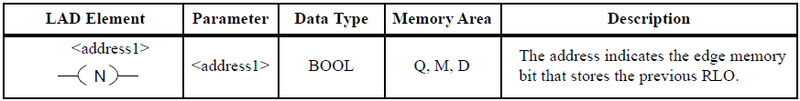
Bit Logic Instr. ---( N )---Negative RLO Edge Detection
The operation Negative RLO Edge Detection recognizes a change in the entered address from 1 to 0 (falling edge) and displays this as RLO = 1 after the operation
The current signal state in the RLO is compared with the signal state of the address, the edge memory bit
If the signal state of the address is "1" and the RLO was "0" before the instruction, the RLO will be "1" (pulse) after this instruction, and "0" in all other cases.

Slide 17
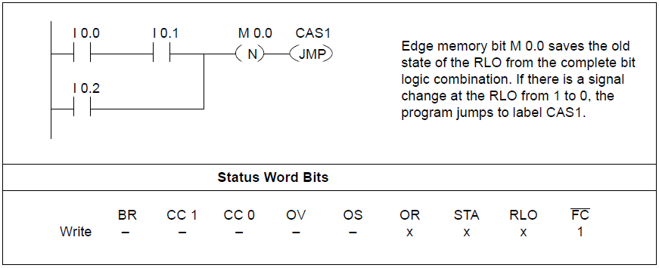
Bit Logic Instr. ---( N )---Negative RLO Edge Detection

Slide 18
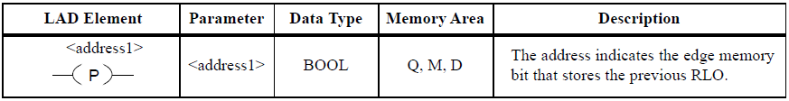
Bit Logic Instr.: ---( P )--- Positive RLO Edge Detection
The operation Positive RLO Edge Detection recognizes a change in the entered address from 0 to 1 (rising edge) and displays this as RLO = 1 after the operation
The current signal state in the RLO is compared with the signal state of the address, the edge memory bit
If the signal state of the address is "0" and the RLO was "1" before the instruction, the RLO will be "1" (pulse) after this instruction, and "0" in all other cases

Slide 19
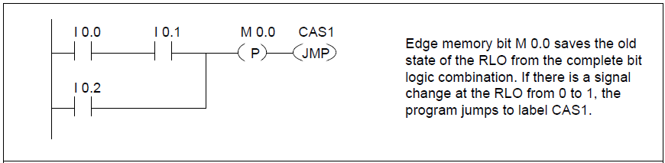
Bit Logic Instr.: ---( P )--- Positive RLO Edge Detection

Slide 20
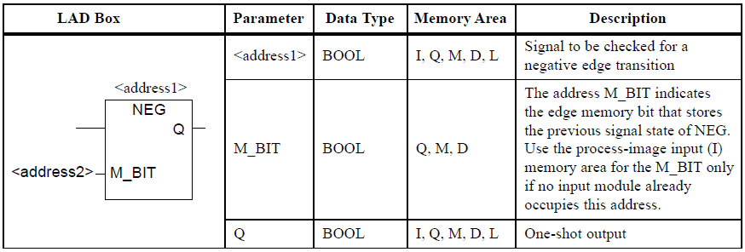
Bit Logic Instructions: Address Negative Edge Detection
NEG (Address Negative Edge Detection) compares the signal state of <address1> with the signal state from the previous scan, which is stored in <address2>
If there is a change from 1 to 0, output Q is 1. Otherwise it is 0

Slide 21
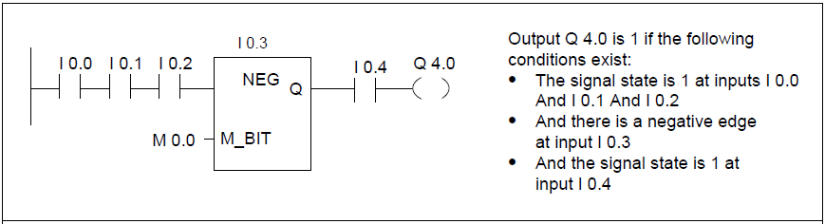
Bit Logic Instructions: Address Negative Edge Detection

Slide 22
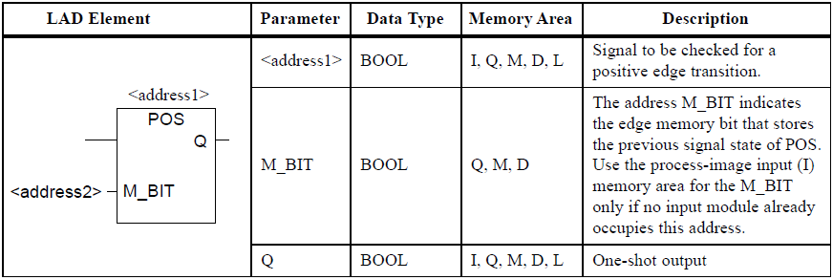
Bit Logic Instructions: Address Positive Edge Detection
POS (Address Positive Edge Detection) compares the signal state of <address1> with the signal state from the previous scan, which is stored in <address2>
If there is a change from 0 to 1, output Q is 1. Otherwise, it is 0

Slide 23
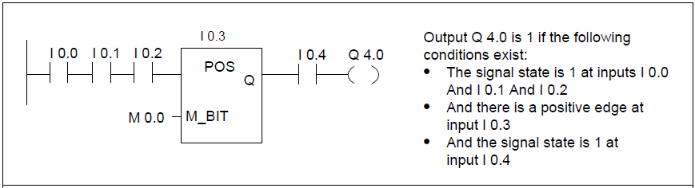
Bit Logic Instructions: Address Positive Edge Detection

