Slide 1
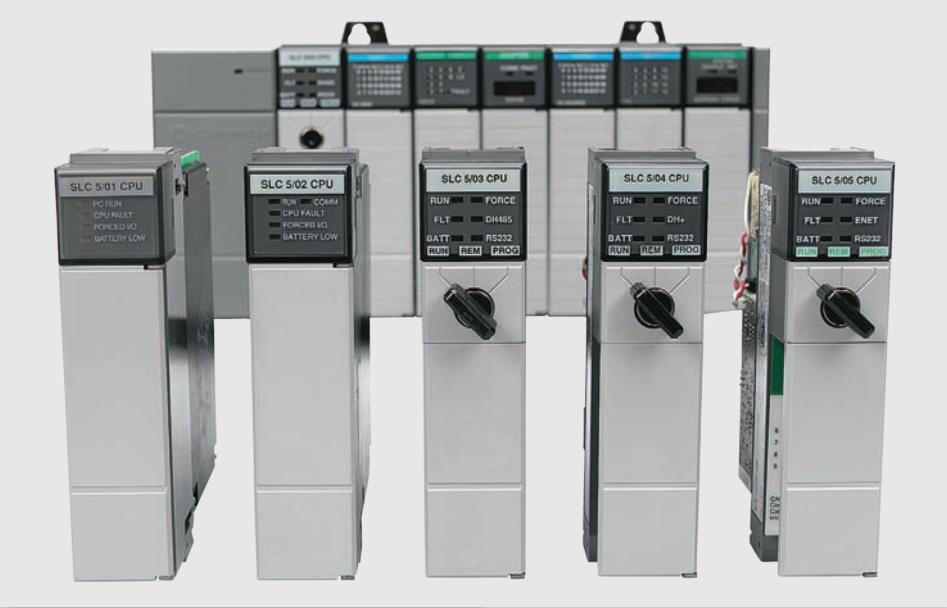
Developing Fundamental I/O discrete devices

Slide 2
Electromagnetic Control Relays
An electrical relay is a magnetic switch. It uses electromagnetism to switch contacts.
A relay will usually have only one coil but may have any number of different contacts
Electromechanical control relay

Slide 3
Electromagnetic Control Relays
The coil and contacts are insulated from each other; therefore, under normal conditions, no electric circuit will exist between them
The letter M frequently indicates a motor starter, while CR is used for control relays
Normally open (NO) contacts are defined as those contacts that are open when no current flows through the coil but that close as soon as the coil conducts a current or is energized
Normally closed (NC) contacts are closed when the coil is de-energized and open when the coil is energized
Control relay coils and contacts have separate ratings. Coils are rated for the type of operating current (DC or AC) and normal operating voltage

Slide 4
Electromagnetic Control Relays
Relay operation

Slide 5
Electromagnetic Control Relays
Relay normally open and normally closed contacts

Slide 6
Contactors
A contactor is a special type of relay designed to handle heavy power loads that are beyond the capability of simple control relays
Unlike relays, contactors are designed to make and break higher powered circuits without being damaged
Such loads include lights, heaters, transformers, capacitors, and electric motors for which overload protection is provided separately or not required

Slide 7
Contactors
Three-pole magnetic contactor

Slide 8
Contactors
Contactor used in conjunction with a PLC output

Slide 9
Motor Starters
A motor starter is designed to provide power to motors
The motor starter is made up of a contactor with an overload relay attached physically and electrically
Motor starter is a contactor with an attached
overload relay

Slide 10
Motor Starters
The function of the overload relay can be summarized as follows:
Overload relays are designed to meet the special protective needs of motor control circuits
They allow harmless temporary overloads that occur when a motor starts
The overload relay will trip and disconnect power to the motor if an overload condition persists
Overload relays can be reset after the overload condition has been corrected

Slide 11
Motor Starters
Three-phase magnetic motor starter

Slide 12
Motor Starters
PLC control of a motor

Slide 13
Manually Operated Switches
Manually operated switches are controlled by hand such as toggle switches, pushbutton switches, knife switches, and selector switches.
Pushbutton switches are the most common form of manual control and can be divided as:
Normally open (NO) pushbutton , which makes a circuit when it is pressed
Normally closed (NC) pushbutton, which opens the circuit when it is pressed
Break-before-make pushbutton in which the top section contacts are NC and the bottom section contacts are NO. When the button is pressed, the top contacts open before the bottom contacts are closed

Slide 14
Manually Operated Switches
Commonly used types of pushbutton switches

Slide 15
Manually Operated Switches
The selector switch is another common manually operated switch
The main difference between a pushbutton and selector switch is the operator mechanism. A selector switch operator is rotated (instead of pushed) to open and close contacts of the attached contact block
Three-position selector switch

Slide 16
Manually Operated Switches
Dual in-line package (DIP) switches are small switch assemblies designed for mounting on printed circuit board modules
The pins or terminals on the bottom of the DIP switch are the same size and spacing as an integrated circuit (IC) chip
DIP switches use binary (on/off) settings to set the parameters for a particular module
DIP switch

Slide 17
Mechanically Operated Switches
A mechanically operated switch is controlled automatically by factors such as pressure, position, or temperature
The limit switch is a very common industrial control device. Limit switches are designed to operate only when a predetermined limit is reached, and they are usually actuated by contact with an object such as a cam
Mechanically operated limit switch

Slide 18
Mechanically Operated Switches
The temperature switch, or thermostat is used to sense temperature changes. Although there are many types available, they are all actuated by some specific environmental temperature change
Temperature switch

Slide 19
Mechanically Operated Switches
Pressure switches are used to control the pressure of liquids and gases. Although many different types are available, they are all basically designed to actuate (open or close) their contacts when a specified pressure is reached
Pressure switches can be pneumatically (air) or hydraulically (liquid) operated switches
Pressure switch

Slide 20
Mechanically Operated Switches
Level switches are used to sense liquid levels in vessels and provide automatic control for motors that transfer liquids from sumps or into tanks. They are also used to open or close piping solenoid valves to control fluids
Float type level switch

Slide 21
Sensors
Sensors are used for detecting, and often measuring, the magnitude of something
They convert mechanical, magnetic, thermal, optical, and chemical variations into electric voltages and currents
Sensors are usually categorized by what they measure, and they play an important role in modern manufacturing process control

Slide 22
Proximity Sensor
Proximity sensors or switches are devices that detect the presence of an object (usually called the target) without physical contact
These solid-state electronic devices are completely encapsulated to protect against excessive vibration, liquids, chemicals, and corrosive agents found in the industrial environment
Proximity sensor

Slide 23
Proximity Sensor
Proximity sensors are used when:
The object being detected is too small, lightweight, or soft to operate a mechanical switch
Rapid response and high switching rates are required, as in counting or ejection control applications
An object has to be sensed through nonmetallic barriers such as glass, plastic, and paper cartons
Unfriendly environments demand improved sealing properties, preventing proper operation of mechanical switches

Slide 24
Proximity Sensor
Proximity sensors are used when:
The object being detected is too small, lightweight, or soft to operate a mechanical switch
Rapid response and high switching rates are required, as in counting or ejection control applications
An object has to be sensed through nonmetallic barriers such as glass, plastic, and paper cartons
Unfriendly environments demand improved sealing properties, preventing proper operation of mechanical switches
Long life and reliable service are required
A fast electronic control system requires a bounce free input signal

Slide 25
Inductive proximity sensor
Inductive proximity sensors are used to detect both ferrous metals (containing iron) and nonferrous metals (such as copper, aluminum, and brass)
Inductive proximity sensors operate under the electrical principle of inductance, where a fluctuating current induces an electromotive force (emf) in a target object
Inductive proximity sensor

Slide 26
Inductive proximity sensor
The operation of inductive proximity sensor can be summarized as follows:
The oscillator circuit generates a high-frequency electromagnetic field that radiates from the end of the sensor
When a metal object enters the field, eddy currents are induced in the surface of the object
The eddy currents on the object absorb some of the radiated energy from the sensor, resulting in a loss of energy and change of strength of the oscillator
The sensor’s detection circuit monitors the oscillator’s strength and triggers a solid-state output at a specific level
Once the metal object leaves the sensing area, the oscillator returns to its initial value.

Slide 27
Inductive proximity sensor: wiring diagram
Typical three-wire DC sensor connection
Typical two-wire DC sensor connection

Slide 28
Inductive proximity sensor: sensing range
Hysteresis is the distance between the operating point when the target approaches the proximity sensor face and the release point when the target is moving away from the sensor face
Most proximity sensors come equipped with an LED status indicator to verify the output switching action
Proximity sensor sensing range

Slide 29
Capacitive proximity sensors
Capacitive proximity sensors are similar to inductive proximity sensors. The main differences between the two types are that capacitive proximity sensors produce an electrostatic field instead of an electromagnetic field and are actuated by both conductive and nonconductive materials
Capacitive proximity sensor

Slide 30
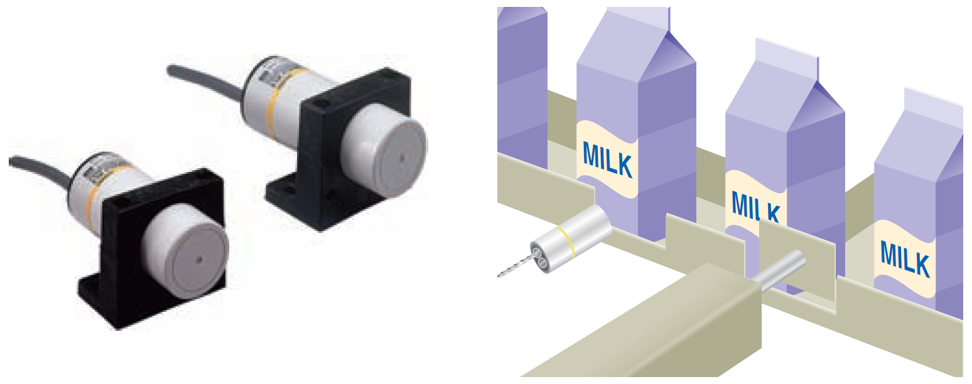
Capacitive proximity sensors
Capacitive proximity sensors will sense metal objects as well as nonmetallic materials such as paper, glass, liquids, and cloth
They typically have a short sensing range of about 1 inch regardless of type of material being sensed
The larger the dielectric constant of a target, the easier it is for the capacitive sensor to detect. This makes possible the detection of materials inside nonmetallic containers
Capacitive proximity
sensor liquid detection

Slide 31
Magnetic Reed Switch
A magnetic reed switch is composed of two flat contact tabs that are hermetically sealed (airtight) in a glass tube filled with protective gas
When a magnetic force is generated parallel to the reed switch, the reeds become flux carriers in the magnetic circuit. The overlapping ends of the reeds become opposite magnetic poles, which attract each other
Magnetic reed switch

Slide 32
Light Sensors
A photoelectric sensor is an optical control device that operates by detecting a visible or invisible beam of light and responding to a change in the received light intensity
Photoelectric sensors are composed of two basic components: a transmitter (light source) and a receiver (sensor)
Photoelectric sensor

Slide 33
Light Sensors
The scan technique refers to the method used by photoelectric sensors to detect an object
The through-beam scan technique (also called direct scan) places the transmitter and receiver in direct line with each other
Through-beam scan

Slide 34
Light Sensors
In a retroreflective scan, the transmitter and receiver are housed in the same enclosure
This arrangement requires the use of a separate reflector or reflective tape mounted across from the sensor to return light back to the receiver
Retroreflective scan

Slide 35
Light Sensors
Fiber optic sensors use a flexible cable containing tiny fibers that channel light from emitter to receiver
Fiber optic sensor systems are completely immune to all forms of electrical interference
Fiber optic sensors

Slide 36
Light Sensors
Bar code technology is widely implemented in industry to enter data quickly and accurately
A light source within the scanner illuminates the bar code symbol; those bars absorb light, and spaces reflect light
A photodetector collects this light in the form of an electronic-signal pattern representing the printed symbol.
PLC bar code application

Slide 37
Ultrasonic Sensors
An ultrasonic sensor operates by sending high-frequency sound waves toward the target and measuring the time it takes for the pulses to bounce back
The time taken for this echo to return to the sensor is directly proportional to the distance or height of the object because sound has a constant velocity
Ultrasonic sensor

Slide 38
Strain/Weight Sensors
A strain gauge converts a mechanical strain into an electric signal
Strain gauges are based on the principle that the resistance of a conductor varies with length and crosssectional area
The force applied to the gauge causes the gauge to bend which in turn changes its resistance
Strain gauge load cell

Slide 39
Temperature Sensors
The thermocouple is the most widely used temperature sensor
Thermocouples operate on the principle that when two dissimilar metals are joined, a predictable DC voltage will be generated that relates to the difference in temperature between the hot junction and the cold junction
The hot junction (measuring junction) is the joined end of a thermocouple that is exposed to the process where the temperature measurement is desired
The cold junction (reference junction) is the end of a thermocouple that is kept at a constant temperature to provide a reference point
Because of their ruggedness and wide temperature range, thermocouples are used in industry to monitor and control oven and furnace temperatures

Slide 40
Temperature Sensors
Thermocouple temperature sensor

Slide 41
Flow Measurement
Turbine-type flowmeters are a popular means of measurement and control of liquid products in industrial, chemical, and petroleum operations
Turbine flowmeters uses their angular velocity (rotation speed) to indicate the flow velocity
The bladed rotor rotates on its axis in proportion to the rate of the liquid flow through the tube
A magnetic pickup sensor is positioned as close to the rotor
Fluid passing through the flow tube causes the rotor to rotate, which generates pulses in the pickup coil
The frequency of the pulses is then transmitted to readout electronics

Slide 42
Flow Measurement
Turbine type flowmeter

Slide 43
Velocity and Position Sensors
Turbine-type

