Slide 1
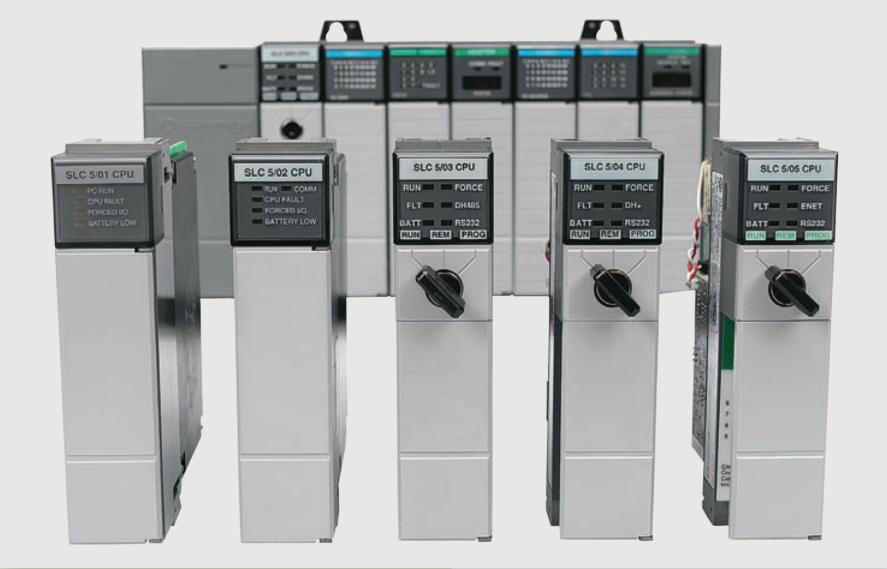
Basics of PLC Programming

Slide 2
Processor Memory Organization
The PLC memory space can be divided into two broad categories: program files and data files
Program files are the part of the processor memory that stores the user ladder logic program. Most instructions require one word of memory
The data files store the information needed to carry out the user program. This includes information such as the status of input and output devices, timer and counter values, data storage
Contents of the data table can be divided into two categories: status data and numbers or codes

Slide 3
S7-300 Memory Organization
The S7-300 has three memory areas in CPU:
Load memory
System memory
Work memory

Slide 4
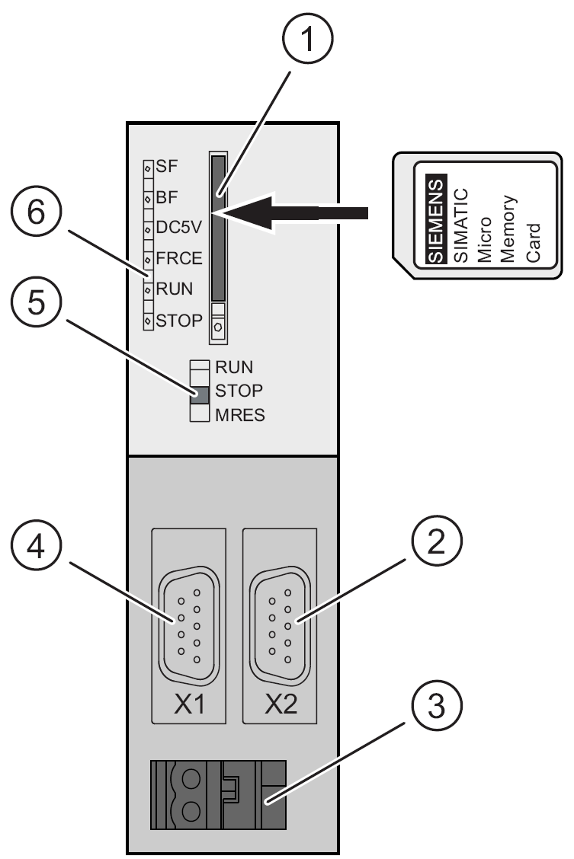
S7-300 Memory Organization: Load memory
The load memory is located on a SIMATIC Micro Memory Card (MMC)
It is used for storing code blocks and data blocks, as well as system data (configuration, connections, module parameters etc.).
It is possible to store the entire configuration data of project on MMC

Slide 5
S7-300 Memory Organization: System memory
The integrated CPU system memory is not expandable
It contains:
The address areas for memory bits, timers and counters
The I/O process image
Local data

Slide 6
S7-300 Memory Organization: Process Input Image
PII is a part of the program memory allocated to storing the on/off status of connected discrete inputs
Connection of an open and closed switch to the PII through the input module

Slide 7
S7-300 Memory Organization: Process Output Image
POI is that part of the program memory allocated to storing the actual on/off status of connected discrete outputs
Connections of pilot lights to the output image table file through the output module

Slide 8
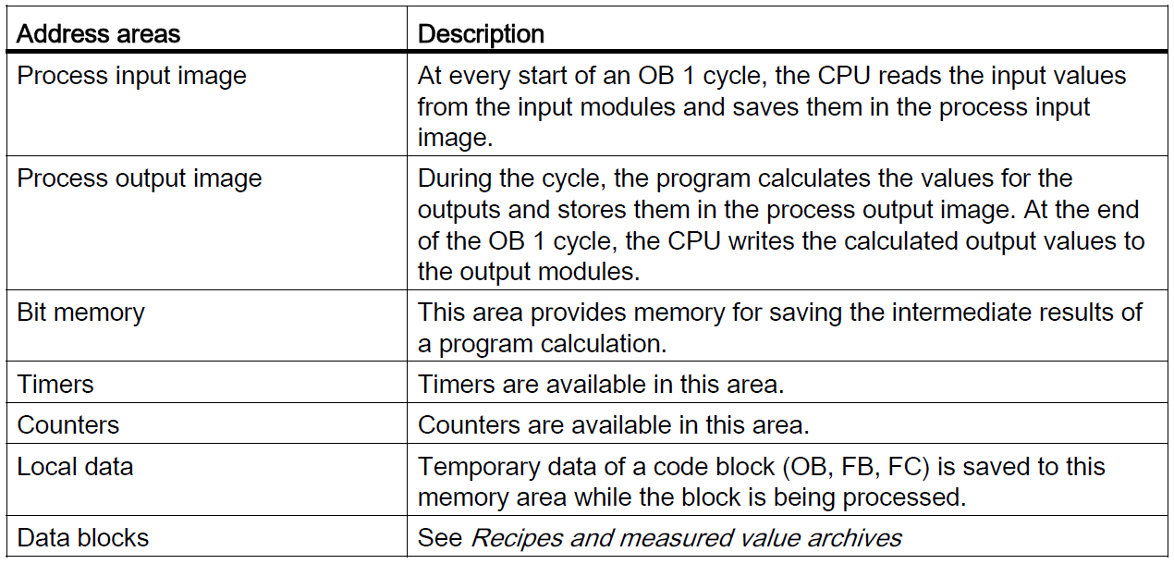
S7-300 Address areas of the system memory

Slide 9
S7-300 Main memory
The main memory is integrated in the CPU and cannot be extended
It is used to execute the code and process user program data
Programs only run in the main memory and system memory

Slide 10
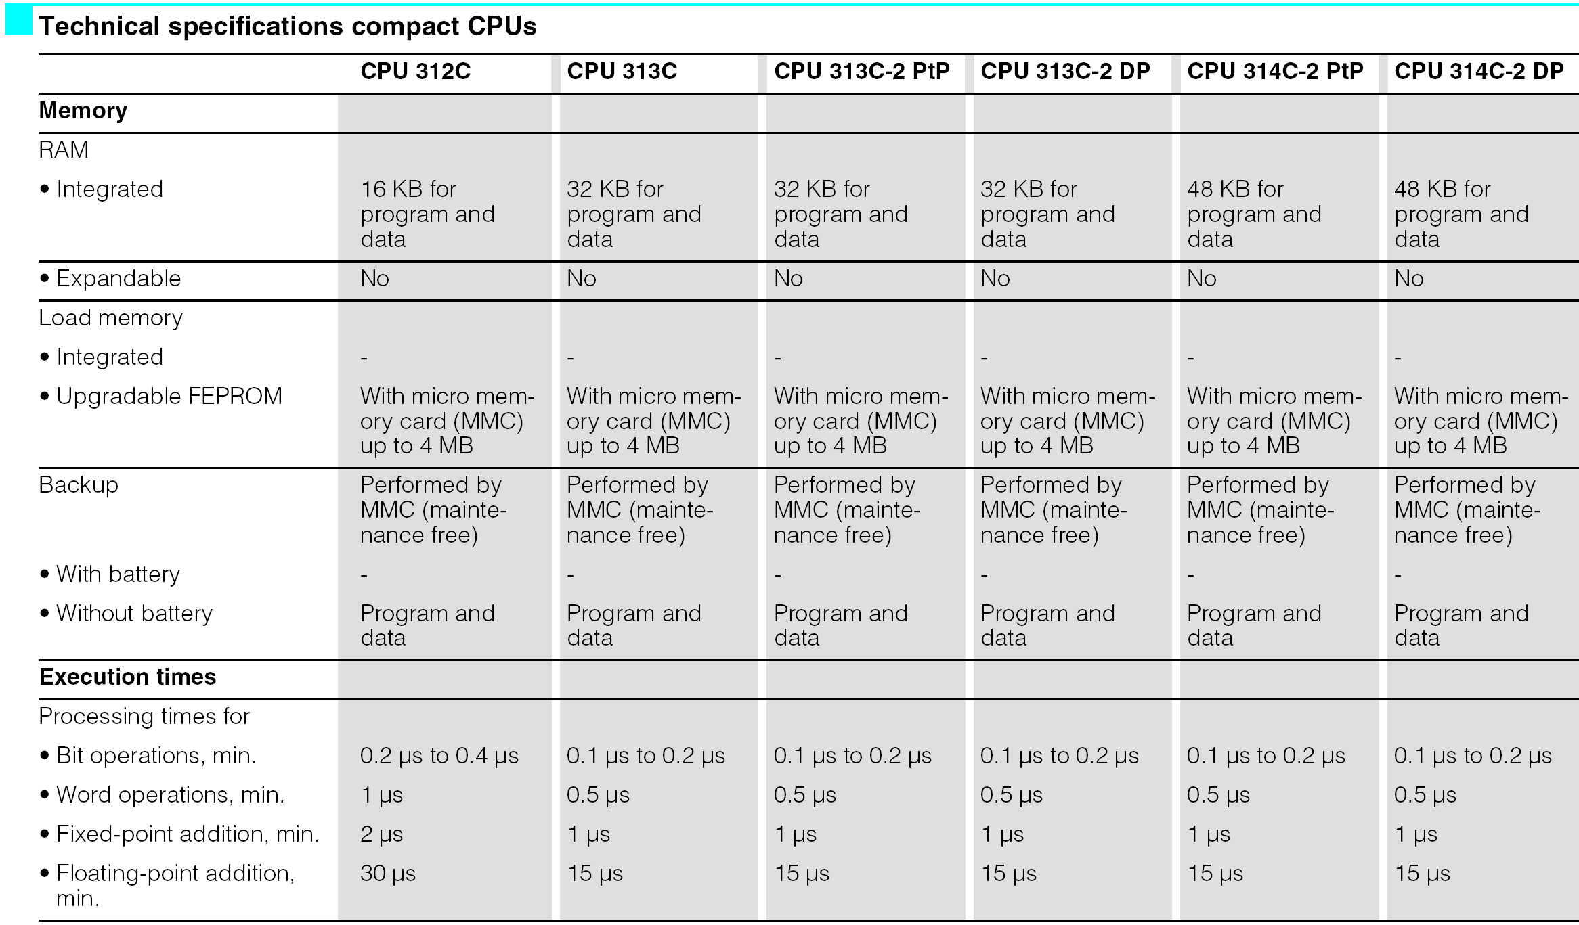
S7-300 Memory specification

Slide 11
S7-300 Retentivity of load memory, system memory, and main memory
Retentive data in the load memory
The program in the load memory is always retentive: It is stored on the SIMATIC Micro Memory Card, where it is protected against power failures or memory resets
Retentive data in the system memory
In configuration (Properties of CPU, Retenativity tab) must be specifed which part of memory bits, timers and counters should be kept retentive and which of them are to be initialized with "0” on restart (warm restart)

Slide 12
S7-300 Retentivity of load memory, system memory, and main memory
Retentive data in the main memory
The contents of retentive DBs are always retentive at restart and POWER ON/OFF
Retentive data blocks can be uploaded to the main memory in accordance with the maximum limit allowed by the main memory
Non-retentive DBs are initialized from the load memory with their initial values at restart or POWER ON/OFF
Non-retentive data blocks and code blocks can be loaded in accordance with the maximum main memory limit

Slide 13
Program Scan
PLC program scan cycle

Slide 14
Program Scan
When a PLC executes a program, it must know—in real time—when external devices controlling a process are changing
During each operating cycle, the processor reads all the inputs, takes these values, and energizes or de-energizes the outputs according to the user program
This process is known as a program scan cycles
Single PLC operating cycle consisting of the:
Input scan
Program scan
Output scan
Housekeeping duties (communications and diagnostics)

Slide 15
Program Scan
The time required to make a single scan can vary from about 1 millisecond to 20 milliseconds
The scan time is a function of the following:
The speed of the processor module
The length of the ladder program
The type of instructions executed
The actual ladder true/false conditions

Slide 16
Program Scan
The For each rung executed, the PLC processor will:
Examine the status of the Process Input Image table bits
Solve the ladder logic in order to determine logical continuity
Update the appropriate Process Output Image table bits, if necessary
Copy the output image table status to all of the output terminals
Copy the status of all of the input terminals to the input image table

Slide 17
Program Scan: Data flow
Overview of the data flow during the scan process

Slide 18
Program Scan
For each rung executed, the PLC processor will:
Step 1 - Update the input image table by sensing the voltage of the input terminals. Based on the absence or presence of a voltage, a 0 or a 1 is stored into the memory bit location designated for a particular input terminal
Step 2 - Solve the ladder logic in order to determine logical continuity. The processor scans the ladder program and evaluates the logical continuity of each rung by referring to the process input image table to see if the input conditions are met. If the conditions controlling an output are met, the processor immediately writes a 1 in its memory location, indicating that the output will be turned ON; conversely, if the conditions are notmet a 0 indicating that the device will be turned OFF is written into its memory location

Slide 19
Program Scan
For each rung executed, the PLC processor will:
Step 3 – Update the actual states of the output devices by transferring the output table results to the output module, thereby switching the connected output devices ON (1) or OFF (0). If the status of any input devices changes when the processor is in step 2 or 3, the output condition will not react to them until the next processor scan

Slide 20
Program Scan: single rung program
Scan process applied to a single rung program

Slide 21
Program Scan: multiple rung program
Scan process applied to a multiple rung program

Slide 22
PLC Programming Languages
The standard IEC 61131 standardize five languages for programming PLC :
Ladder Diagram (LD) — a graphical depiction of a process with rungs of logic, similar to the relay ladder logic schemes
Function Block Diagram (FBD) — a graphical depiction of process flow using simple and complex interconnecting blocks
Sequential Function Chart (SFC) — a graphical depiction of interconnecting steps, actions, and transitions
Instruction List (IL) — a low-level, text-based language that uses mnemonic instructions.
Structured Text (ST) — a high-level, text-based language such as BASIC, C, or PASCAL specifically developed for industrial control applications.

Slide 23
PLC Programming Languages
Standard IEC 61131 languages associated with PLC programming

Slide 24
PLC Programming Languages: Ladder diagram
The Ladder diagram language is the most commonly used PLC language and is designed to mimic relay logic
Hardwired relay control circuit
Equivalent ladder diagram (LD) program

Slide 25
PLC Programming Languages: Function Block Diagram
The Functional block diagram programming uses instructions that are programmed as blocks wired together on screen to accomplish certain functions. Typical types of function blocks include logic, timers, and counters
Function block diagram equivalents to ladder logic contacts
PLC ladder and equivalent function block diagram

Slide 26
PLC Programming Languages: Sequential Function Chart
Sequential function chart programming language is similar to a flowchart
SFC programming is designed to accommodate the programming of more advanced processes
Major elements of a sequential function chart program

Slide 27
PLC Programming Languages: Structured Text
Structured text is a high level text language primarily used to implement complex procedures that cannot be easily expressed with graphical languages
PLC ladder and equivalent structured text
program

Slide 28
Bit Logic Instructions: ---| |--- Normally Open Contact
Is closed when the bit value stored at the PII is equal to "1". When the contact is closed, ladder rail power flows across the contact and the result of logic operation (RLO) = "1”
Otherwise, if the signal state at the PII is "0", the contact is open. When the contact is opened, power does not flow across the contact and the result of logic operation (RLO) = "0"
Examine If Closed instruction

Slide 29
Bit Logic Instructions: ---| / |--- Normally Closed Contact
Is closed when the bit value stored at the PII is equal to “0". When the contact is closed, ladder rail power flows across the contact and the result of logic operation (RLO) = "1”
Otherwise, if the signal state at the PII is “1", the contact is open. When the contact is opened, power does not flow across the contact and the result of logic operation (RLO) = "0"
Examine If Opened instruction

Slide 30
Bit Logic Instructions: ---( ) Output Coil
This instruction looks and operates like a relay coil and is associated with a POI memory bit. This instruction signals the PLC to energize (switch on) or de-energize (switch off ) the output
Output Coil energize instruction

Slide 31
Bit Logic Instructions Addressing
Those addresses indicates what PLC input is connected to what input device and what PLC output will drive what output device
Addressing formats can vary from one PLC family to another as well as for different manufacturers
The assignment of an I/O address can be included in the I/O connection diagram
I/O connection diagram

Slide 32
Bit Logic Instructions Addressing
Addressing format for Siemens S7-300

Slide 33
Multiple Branch: OR Instruction
Branch instructions are used to create parallel paths of input condition instructions. This allows more than one combination of input conditions (OR logic) to establish logic continuity in a rung
Typical branch instruction

Slide 34
Multiple Branch: OR Instruction
Input and output branches can be nested to avoid redundant instructions and to speed up processor scan time
Nested contact program

Slide 35
Internal Relay Instructions
Most PLCs have an area of the memory allocated for what are known as internal storage bits. These storage bits are also called internal outputs, internal coils, internal control relays, or simply internal memory bits (M-memory)
Programmed internal relay control

Slide 36
Modes of Operation
A processor has basically two modes of operation: the program mode and some variation of the run mode
Program Mode is used to enter a new program, edit or update an existing program, upload files, download files, document (print out) programs, or change any software configuration file in the program. When the PLC is switched into the program mode, all outputs from the PLC are forced off regardless of their rung logic status, and the ladder I/O scan sequence is halted
Run Mode is used to execute the user program. Input devices are monitored and output devices are energized accordingly. After all instructions have been entered in a new program or all changes made to an existing program, the processor is put in the run mode

Slide 37
Modes of Operation
Test Mode is used to operate or monitor the user program without energizing any outputs. The processor still reads inputs, executes the ladder program, and updates the output status table files, but without energizing the output circuits
Remote Mode allows the PLC to be remotely changed between program and run mode by a personal computer connected to the PLC processor. The remote mode may be beneficial when the controller is in a location that is not easily accessible
Three-position keyswitch used to select different processor modes of operation

