Slide 1
Uvod u PLC
PLC često se zove i progamabilni kontroler je tip računara koji se koristi za upravljanje sistemima u industriji, građevinarstvu, infrasktukrurnim objektima
Ima mogućnost memorisanja:
  Logičkih instrukcije
  Aritmetičkih instrukcije
  Sekvencijalnih instrukcije (tajmeri i brojači)
  Instrukcija za komunikaciju
  Specijalnih matematičke instrukcije
  Instrukcija za konverziju podataka
  Instrukcija za upravljačke PID strukture

Slide 2
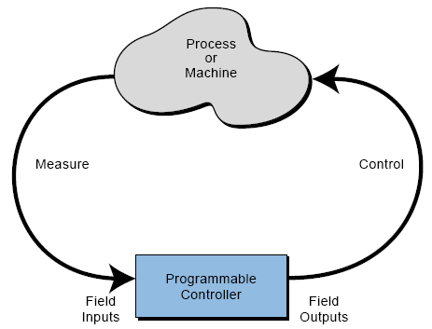
Uvod u PLC
Koncept primjene PLC

Slide 3
Uvod u PLC
PLC imaju više definicija izdvojićemo jednu:
Programabilni logički kontroleri (PLC) su industrijski računari čiji su hardver i softver posebno prilagođeni radu u industrijskim uslovima, a koji se mogu lako programirati i ugrađivati u postojeće industrijske sisteme

Slide 4
Istorijski razvoj PLC
Prvi zahtijev za razvoj PLC dat je u General Motors Corporation davne 1968. godine
Osnovni cilj koji je PLC trebao da zadovolji odnosi se na smanjenje cijene održavanja skupog nefleksibilnog upravljačkog sistema realizovanog sa elektromehaničkim relejima
Neki zahtijevi koje je elektronski uređaj sa fleksibilnošću računara trebao da zadovolji su:
  Radi u industrijskom okruženju
  Da bude lako programabirljiv od strane procesnih inženjera i tehničara
  Da bude više puta upotrebljiv

Slide 5
Istorijski razvoj PLC
Dalji zahtijvi za razvoj PLC odnosili su se na sljedeće:
  Novi upravljački sistem po cijeni mora biti konkurentan sa starim relejnim sistemom upravljanja
  Ulazni i izlazni moduli trebaju biti lako zamjenljivi
  Kontroler bi trebao biti modularan tako da se komponente mogu lako zamjeniti dodati ili popraviti
  Upravljački sistem trebao je da ima mogućnost razmjene podataka sa centralnim upravljačkim sistemom
  Način programiranja kontrolera treba da bude jednostavan i lako razumljiv procesnim inženjerima i tehničarima

Slide 6
PLC danas – hardverska unapređenja
Tehnološki unapređenja PLC i danas postoje i dešavaju se na dva nivoa:
  Hardverski (nove komponente)
  Softverski ( načini programiranja)
Neka od hardverskih unapređenja su:
  Manje vrijeme skan ciklusa zahvaljujući modernijim mikoprocesorima i ostalim elektronskim komponentama
  Velika gustina pakovanja I/O modula smanjuje dimenzije cjelokupnog sistema i cijenu
  Intelingentni mikroprocesorski I/O interfejsi nudi mogućnost distribuiranog procesiranja (PID upravljanje, CAN, Fieldbus, LAN)

Slide 7
PLC danas – hardverska unapređenja
Neka od unapređenja su:
    Poboljšanja u mehaničkoj konstrukciji I/O modula i njihova integracija sa CPU modulom
    Posebni interfejsi koji omogućavaju povezivanje specifičnin senzora na ulaz PLC kao što su: termoparovi, mjerne trake, brzi digitalni ulazi i sl.
    Periferna oprema ima unaprijeđeni operatorski interfejs
    Dokumentacija je standardni dio sistema

Slide 8
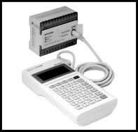
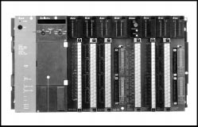
PLC danas - izgled
Mali PLC sa I/O modulima
i ručnom jedinicom za
programiranje
PLC sa većim brojem I/O modula

Slide 9
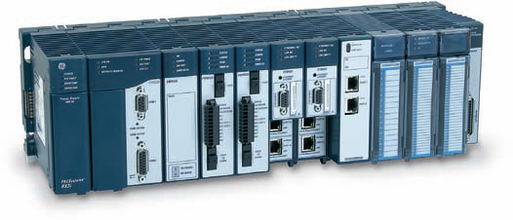
PLC danas - izgled
Mali PLC sa I/O modulima
PLC sa većim brojem I/O modula

Slide 10
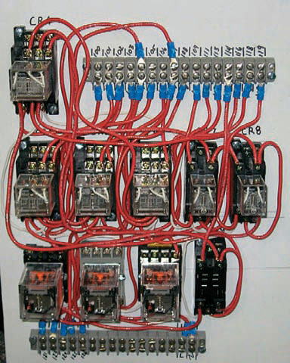
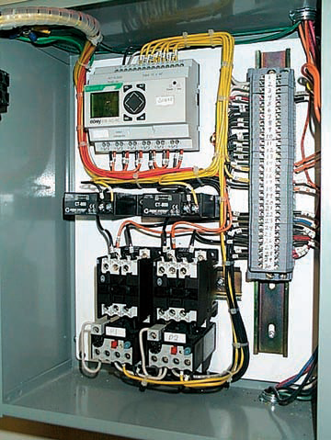
Relay- and PLC-based control panels
Relay based control panel
PLC-based control panel

Slide 11
PLC danas – softverska unapređenja
Neka od unapređenja su:
  PLC se mogu danas programirati objektno – orijentisanim jezicima koji podržavaju IEC 1131-3 standard
  Mali PLC danas podržavaju kompleksnan set instrukcija što proširuje njihovu primjenu
  Jezici visokog nivoa kao što su BASIC i C mogu biti implementirani u nekim modulima kontrolera da bi obezbijedili veću fleksibilnost programiranja
  Složeni funkcionalni blokovi su ugrađeni u leder programe da bi unaprijedili softverske mogućnosti i pojednostavili način programiranja

Slide 12
PLC danas – softverska unapređenja
Neka od unapređenja su:
  Mogućnost jednostavne dijagnostike i otkrivanja grešaka počevši od samog PLC kontrolera preko dijagnostike mašina i procesa kojim PLC upravlja
  Primjena matematika u pokretnom zarezu omogućava kompleksna izračunavanja potrebna pri različitim upravljačkim zadacima
  Unaprijeđena obrada podataka koja podržava kompleksne upravljačke algoritme i akviziciju podataka koja podrazumjeva smještanje praćenje i pretraživanje velike količine podataka

Slide 13
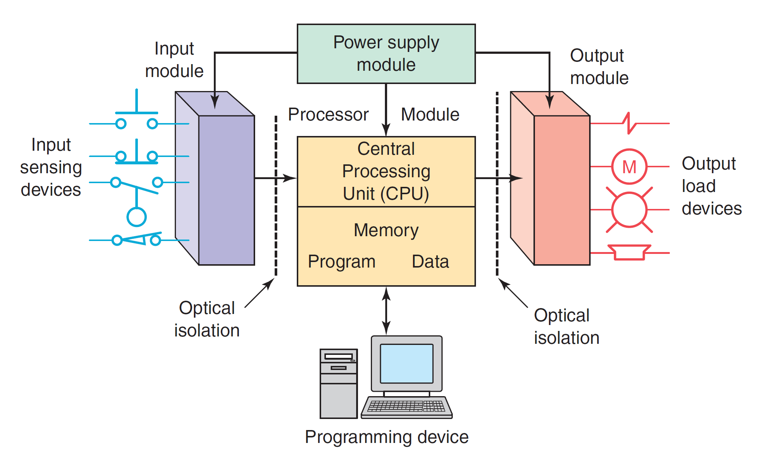
Parts of a PLC

Slide 14
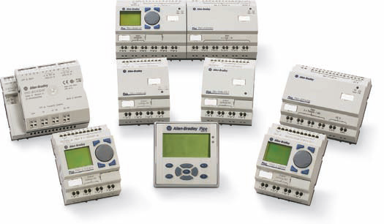
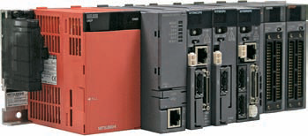
Architecture of PLC
There are two ways in which I/Os (Inputs/Outputs) are incorporated into the PLC: fixed and modular
Modular type
Fixed type

Slide 15
Architecture of PLC –fixed I/O
The processor and I/O modules are packaged together
I/O terminals have a fixed number of connections built in for inputs and outputs
The main advantage of this type of packaging is lower cost. The number of available I/O points varies and usually can be expanded by buying additional units of fixed I/O
One disadvantage of fixed I/O is its lack of flexibility. There are limitation what we can get in the quantities and types dictated by the packaging
Also, if any part in the unit fails, the whole unit has to be replaced

Slide 16
Architecture of PLC –modular I/O
Modular I/O is divided by compartments into which separate modules can be plugged. This feature greatly increases your options and the unit’s flexibility.
The basic modular PLC consists of a rack, power supply, processor module (CPU), input/output (I/O modules), and an operator interface for programming and monitoring.
The modules are plugged into a rack. When a module is slid into the rack, it makes an electrical connection with a series of contacts called the backplane, located at the rear of the rack
The PLC processor is also connected to the backplane and can communicate with all the modules in the rack

Slide 17
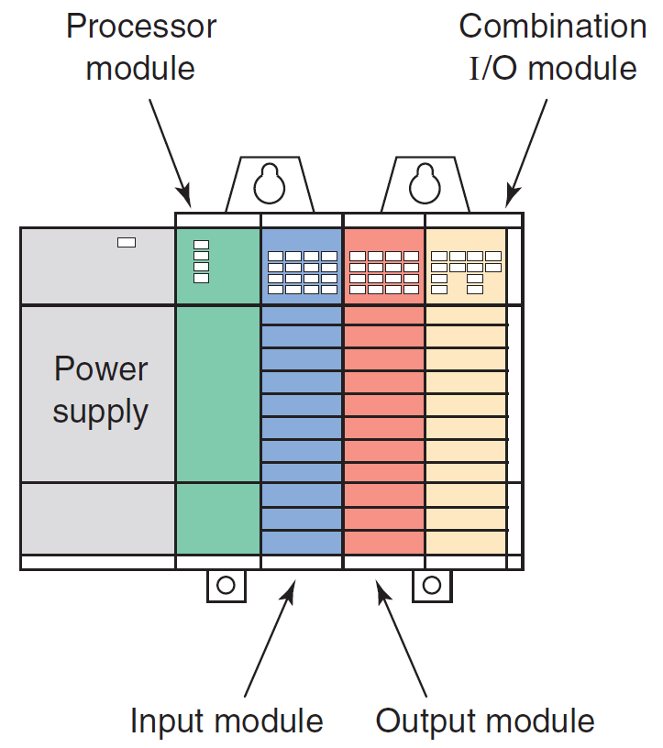
Architecture of PLC –modular I/O

Slide 18
Architecture of PLC –modular I/O

Slide 19
Architecture of PLC –modular I/O: power supply
The power supply supplies DC power to other modules that plug into the rack.
For large PLC systems, this power supply does not normally supply power to the field devices
With larger systems, power to field devices (distributed I/O, sensors, etc) is provided by external alternating current (AC) or direct current (DC) power supplies.
For some small micro PLC systems, the power supply may be used to power field devices

Slide 20
Architecture of PLC –modular I/O
The power supply supplies DC power to other modules that plug into the rack

Slide 21
Architecture of PLC –modular I/O: CPU modul
The processor (CPU) module is the “brain” of the PLC. A typical CPU module usually consists of a microprocessor for impleme-nting the logic and controlling the communications among the modules.
The processor requires memory for storing the results of the logical operations performed by the microprocessor. Memory is also required for the program EPROM or EEPROM plus RAM
The CPU controls all PLC activity and is designed so that the user can enter the desired program in relay ladder logic.
The PLC program is executed as part of a repetitive process referred to as a scan cycle
This process is repeated continuously as long as the PLC is in the run mode

Slide 22
PLC – scan cycle
Typical PLC scan cycle

Slide 23
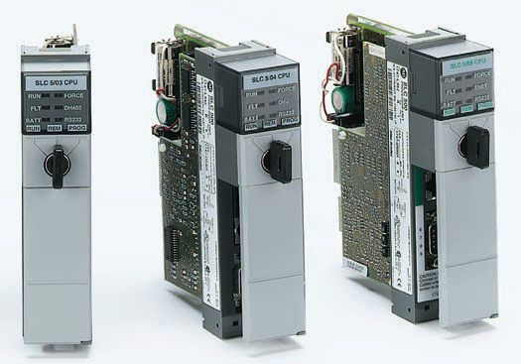
Architecture of PLC –modular I/O
Typical PLC processor modules

Slide 24
Architecture of PLC –I/O modules
The I/O system forms the interface by which field devices are connected to the controller
Input devices such as pushbuttons, limit switches, and sensors are hardwired to the input terminals –input modules
Output devices such as small motors, motor starters, solenoid valves, and indicator lights are hardwired to the output terminals – output modules
To electrically isolate the internal components from the input and output terminals, PLCs commonly employ an optical isolator (optocoupler), which uses light to couple the circuits together

Slide 25
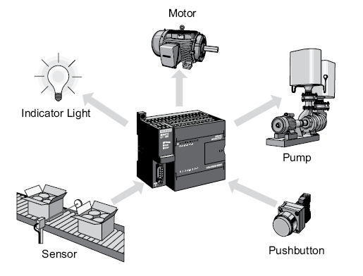
What is connected on input and output modules?
Output modules
Input modules

Slide 26
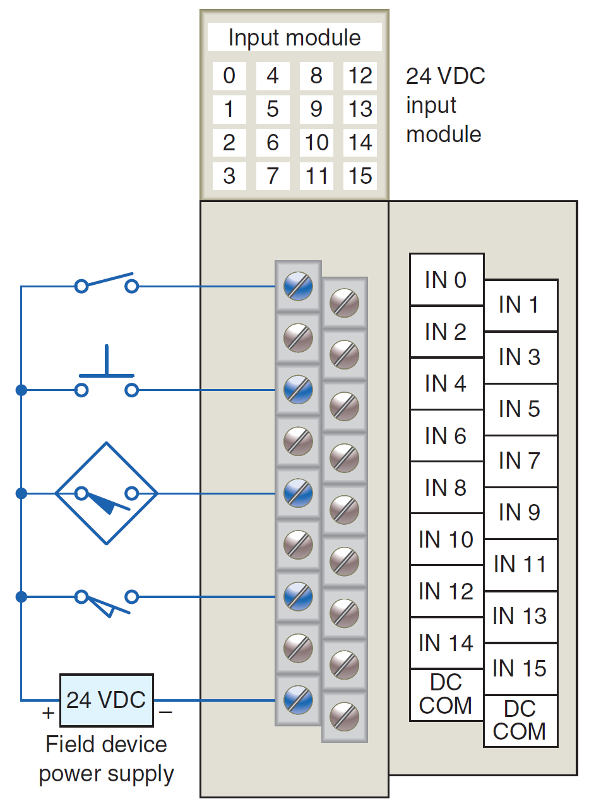
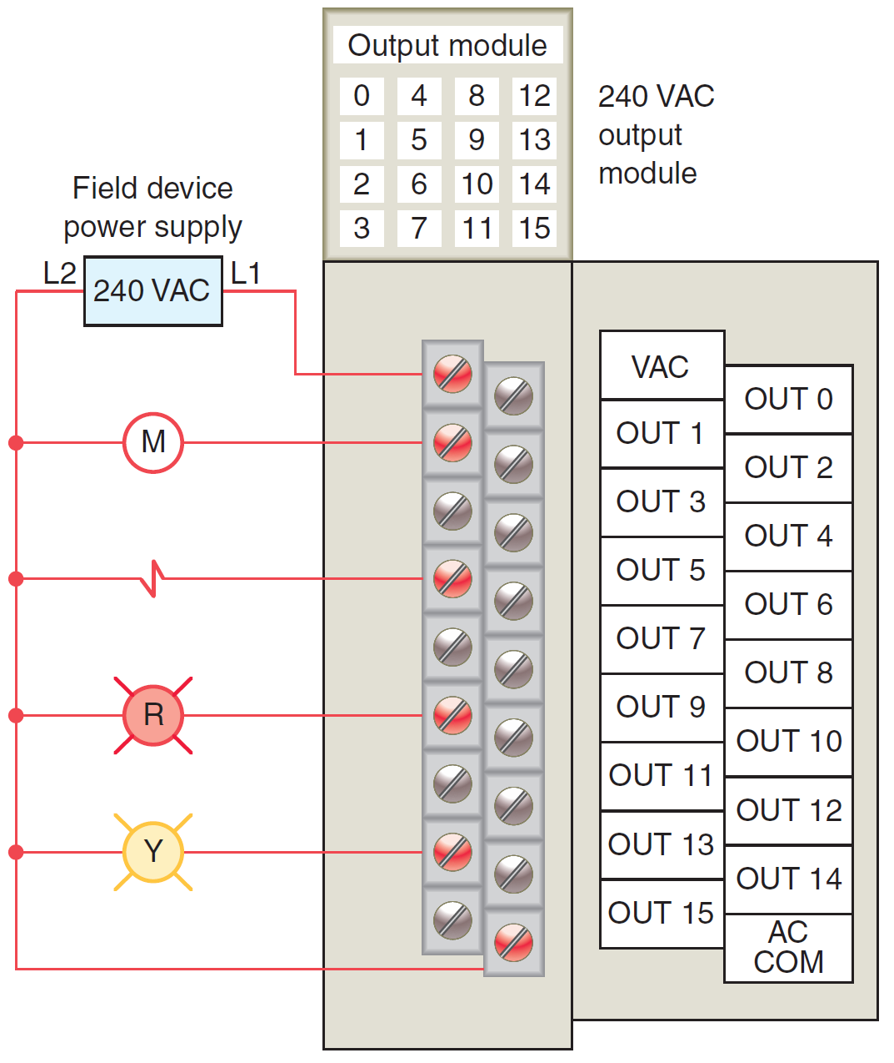
Architecture of PLC – I/O modules
Typical PLC input/output (I/O) system connections

Slide 27
Architecture of PLC – programming devices
A programming device is used to enter the desired program into the memory of the processor
Ladder logic programming language is one of the most popular programming languages which uses graphic symbols to represent control algorithms (program)
A program in ladder logic is similar to a schematic for a relay control circuit and its is easy for people familiar with relay logic control to program the PLC
Hand-held programming devices are sometimes used to program small PLCs because they are inexpensive and easy to use
Both compact hand-held units and laptop computers are frequently used for troubleshooting equipment, modifying programs, and transferring programs to multiple machines

Slide 28
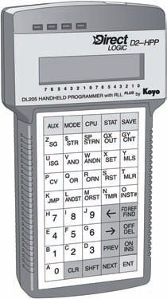
Architecture of PLC – programming devices
Typical hand-held programming device

Slide 29
Architecture of PLC – programming devices
A personal computer (PC) is the most commonly used as programming device
Most brands of PLCs have software available so that a PC can be used as the programming device
This software allows users to create, edit, document, store, and troubleshoot ladder logic programs
The computer monitor is able to display more logic on the screen than can hand-held types, thus simplifying the interpretation of the program
The personal computer communicates with the PLC processor via a serial or parallel data communications link, or Ethernet

Slide 30
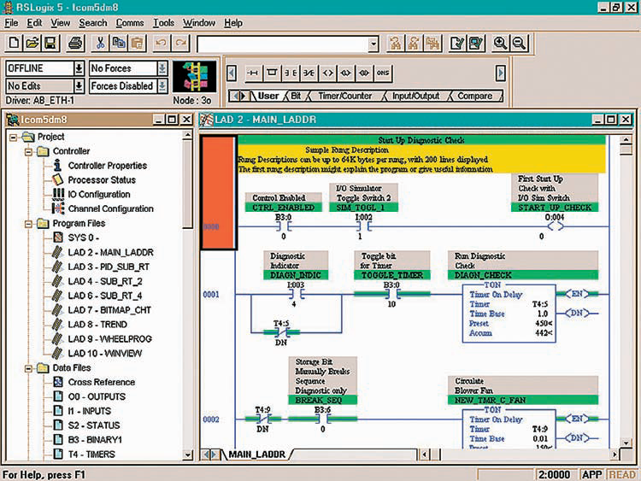
Architecture of PLC –programming devices
Typical PC software used to create a ladder logic program

Slide 31
PLC – programming
A program is a user-developed series of instructions that directs the PLC to execute actions
A programming language provides rules for combining the instructions so that they produce the desired actions
Relay ladder logic (RLL) is the standard programming language usedwith PLCs. Its origin is based on electromechanical relay control
The relay ladder logic program graphically represents rungs of contacts, coils, and special instruction blocks
RLL was originally designed for easy use and understanding for its users and has been modified to keep up with the increasing demands of industry’s control needs

Slide 32
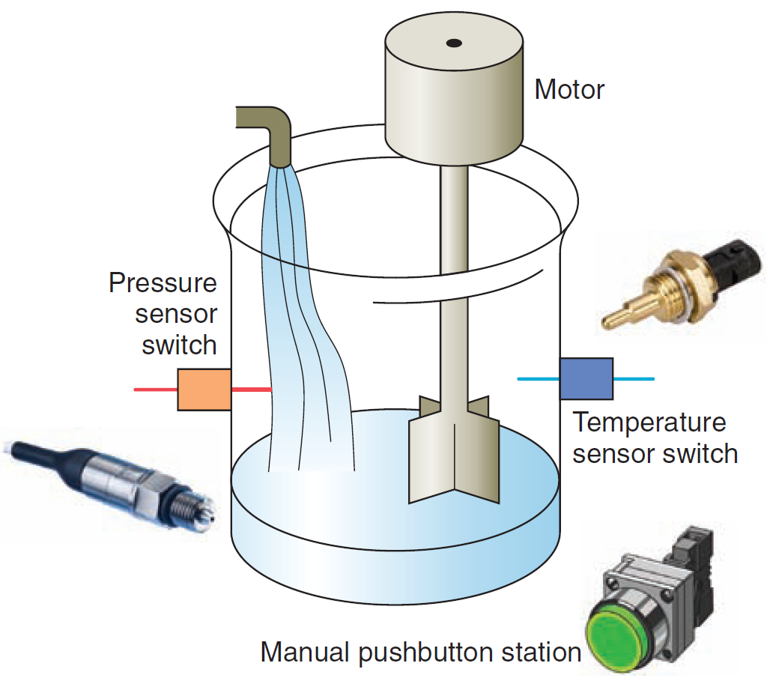
PLC - Principles of Operation: Example
CONTROL TASK:
A mixer motor is to be used to automatically stir the liquid in a tank when the temperature and pressure reach preset values. In addition, direct manual operation of the motor is provided by means of a separate pushbutton station. The process is monitored with temperature and pressure sensor switches that close their contacts when conditions reach their preset values
Mixer process control problem

Slide 33
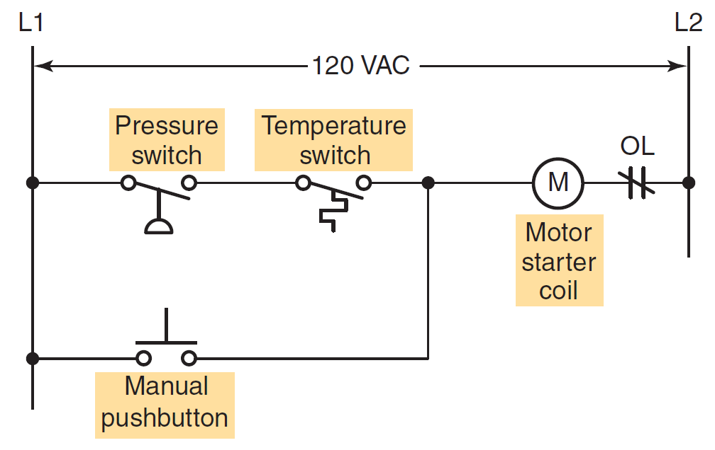
Example - relay leadder method
The motor starter coil (M) is energized when both the pressure and temperature switches are closed or when the manual pushbutton is pressed
Process control relay ladder diagram

Slide 34
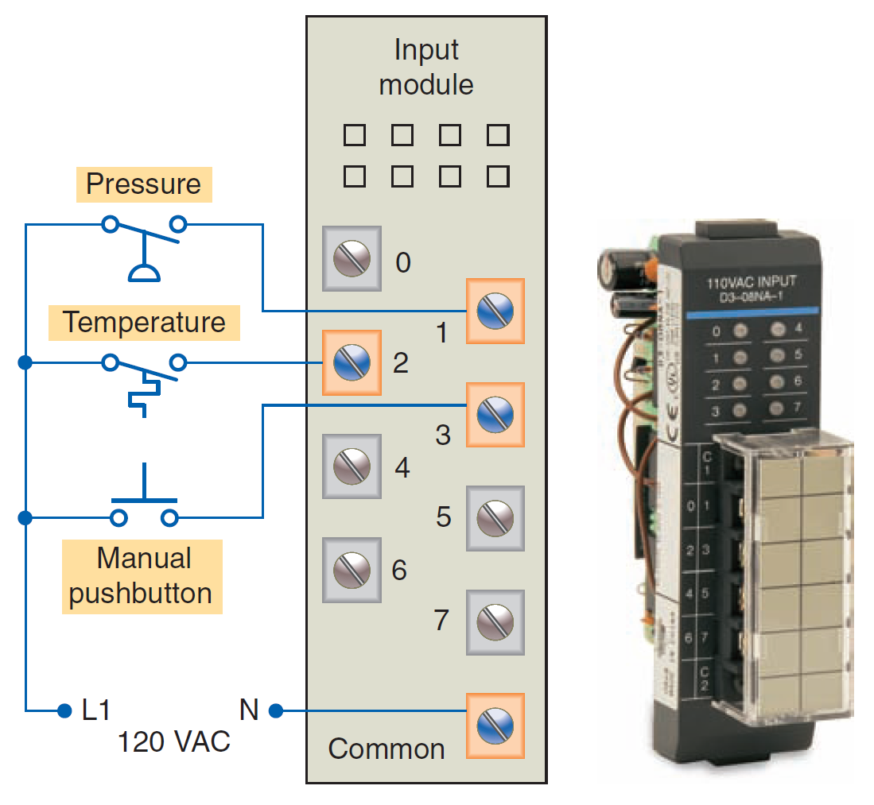
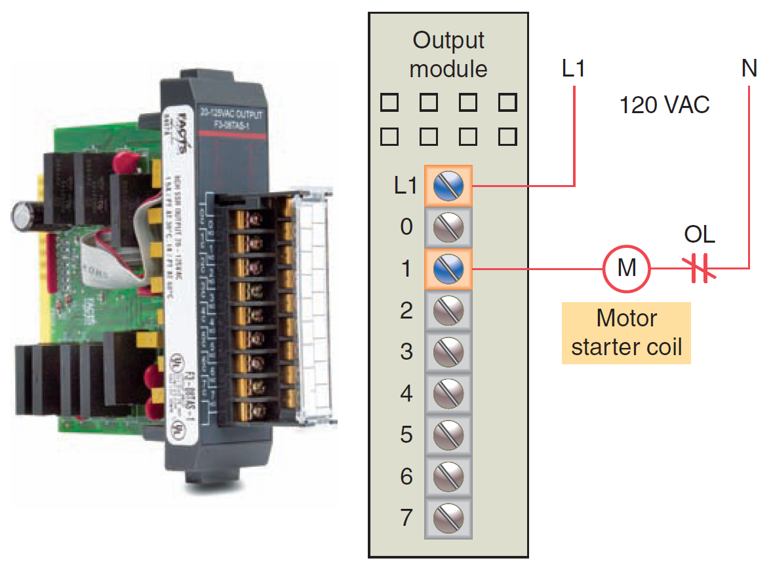
Example – PLC control
Typical wiring connections for a
modular configured input module
Typical wiring connections for a
modular configured output module

Slide 35
PLC - Principles of Operation: Example
A programmable logic controller operates in real time in that an event taking place in the field will result in an operation or output taking place
The process control scheme can be described by the following sequence of events:
  First, the pressure switch, temperature switch, and pushbutton inputs are examined and their status is recorded in the controller’s memory
  A closed contact is recorded in memory as logic 1 and an open contact as logic 0
  Next the ladder diagram is evaluated, with each internal contact given an OPEN or CLOSED status according to its recorded 1 or 0 state

Slide 36
PLC - Principles of Operation: Example
When the states of the input contacts provide logic continuity from left to right across the rung, the output coil memory location is given a logic 1 value and the output module interface contacts will close.
When there is no logic continuity of the program rung, the output coil memory location is set to logic 0 and the output module interface contacts will be open
The completion of one cycle of this sequence by the controller is called a scan. The scan time, the time required for one full cycle, provides a measure of the speed of response of the PLC.
Generally, the output memory location is updated during the scan but the actual output is not updated until the end of the program scan during the I/O scan

Slide 37
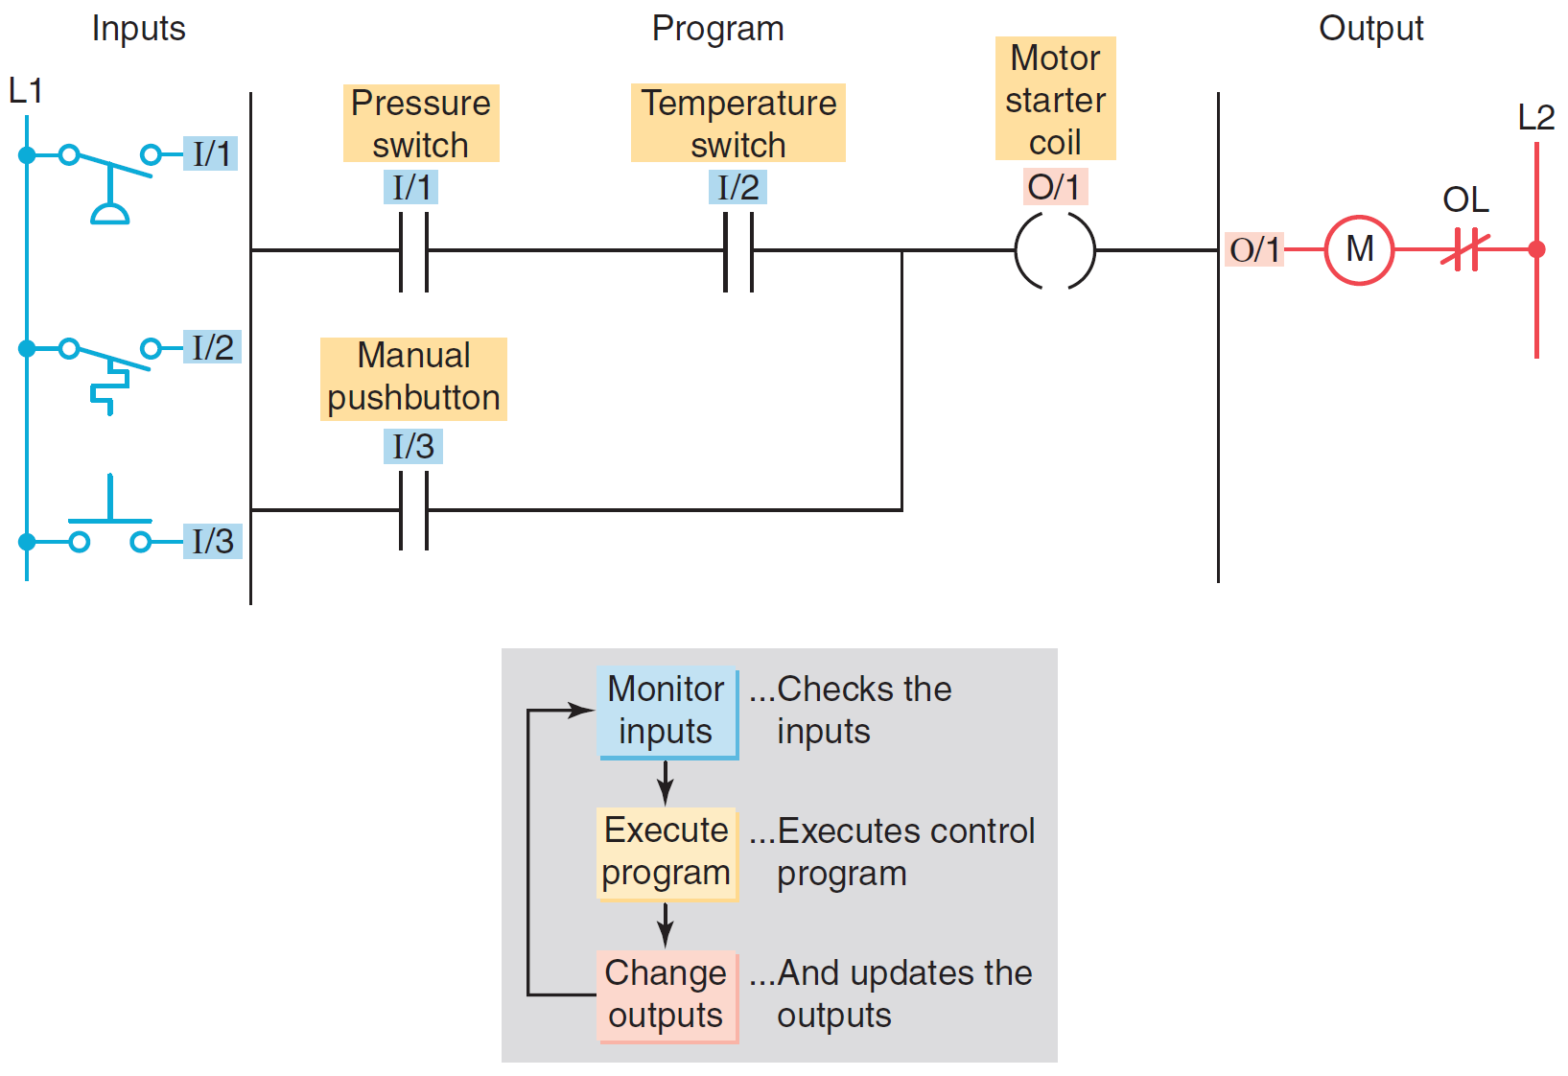
Example – PLC control
Process control PLC ladder logic program with typical addressing scheme

Slide 38
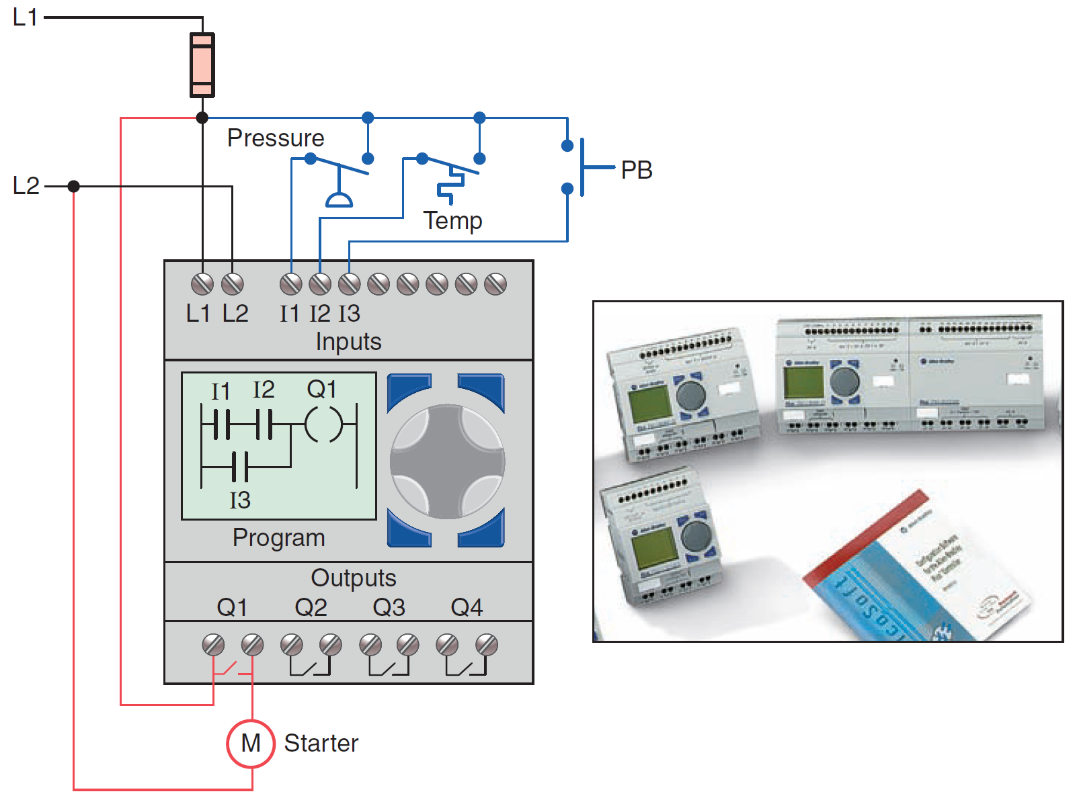
Example – PLC control
Typical wiring required to implement the process control scheme
using a fixed PLC controller

Slide 39
PLC - Modifying the Operation: Example
One of the important features of a PLC is the ease with which the program can be changed
For example, assume that the original process control circuit for the mixing operation must be modified
The change requires that the manual pushbutton control be permitted to operate at any pressure, but not unless the specified temperature setting has been reached

Slide 40
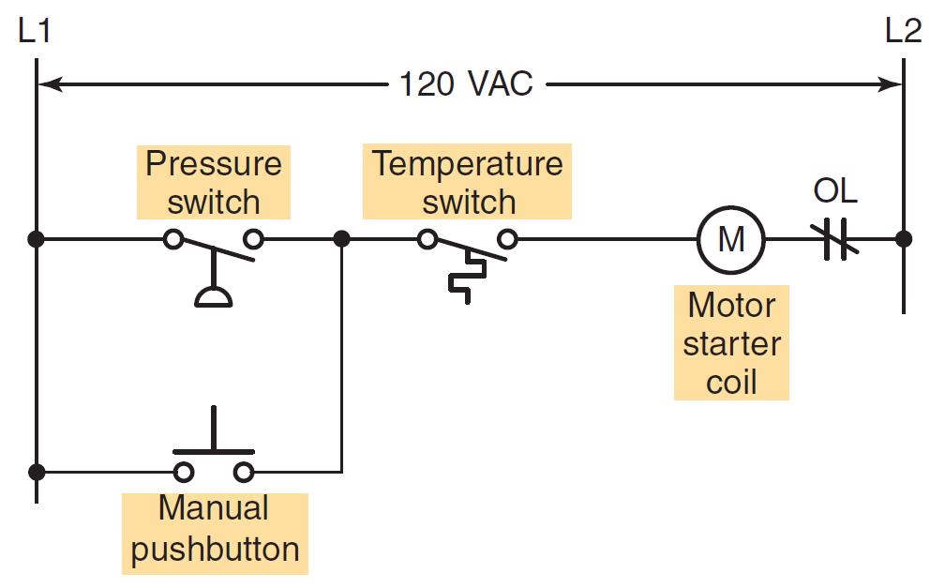
PLC - Modifying the Operation: Example
If a relay system were used, it would require some rewiring of the circuit
Relay ladder diagram for the modified process

Slide 41
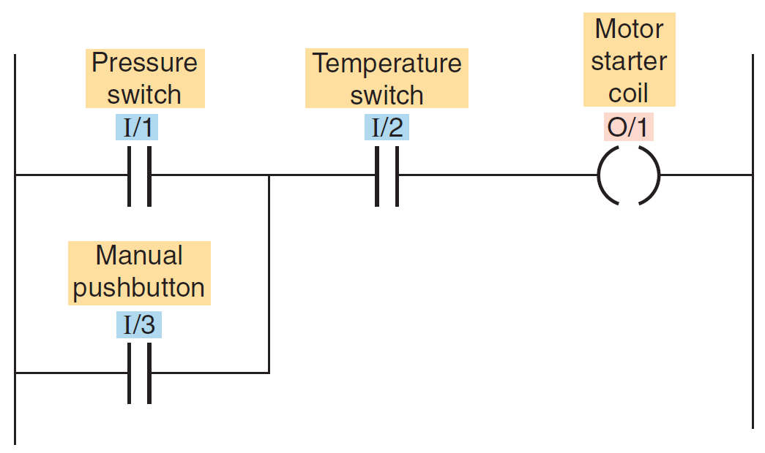
PLC - Modifying the Operation: Example
If a PLC system were used, no rewiring would be necessary. The inputs and outputs are still the same
PLC ladder logic program for the modified process

Slide 42
PLCs versus Computers
Some important characteristics distinguish PLCs from PC:
PLC is designed to operate in the industrial environment with wide ranges of ambient temperature and humidity
The PLC is programmed in relay ladder logic or other easily learned languages
PLCs come equipped with terminals for input and output field devices as well as communication ports
Computers are complex computing machines capable of executing several programs or tasks simultaneously and in any order. Most PLCs, on the other hand, execute a single program in an orderly and sequential fashion from first to last instruction

Slide 43
PLCs versus Computers
PLC control systems have been designed to be easily installed and maintained. Troubleshooting is simplified by the use of fault indicators and messaging displayed on the programmer screen
Input/output modules for connecting the field devices are easily connected and replaced

Slide 44
PLCs versus Computers
Software associated with a PLC but written and run on a personal computer falls into the following two broad categories:
PLC software that allows the user to program and document gives the user the tools to write a PLC program—using ladder logic or another programming language
PLC software that allows the user to monitor and control the process is also called a human machine interface (HMI). It enables the user to view a process—or a graphical representation of a process
Many operator interfaces do not use PLC software. PLCs can be integrated with HMIs but the same software does not program both devices

Slide 45
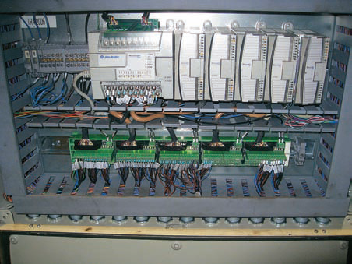
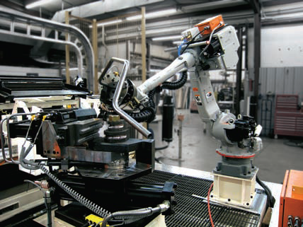
Example of PLC installation
PLC installed in an industrial environment

Slide 46
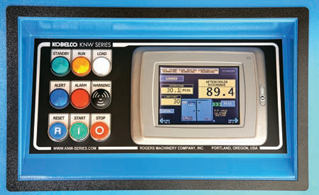
Programming HMI
PLC operator interface and monitor

Slide 47
PLC Size and Application
The criteria used in categorizing PLCs include:
Functionality
Number of inputs and outputs
Cost
Physical size

Slide 48
PLC Size and Application
The I/O count is the most important factor for sizing PLC
  The nano is the smallest size with less than 15 I/O points
  Micro types (15 to 128 I/O points)
  Medium types (128 to 512 I/O points)
  Large types (over 512 I/O points)
Matching the PLC with the application is a key factor in the selection process

Slide 49
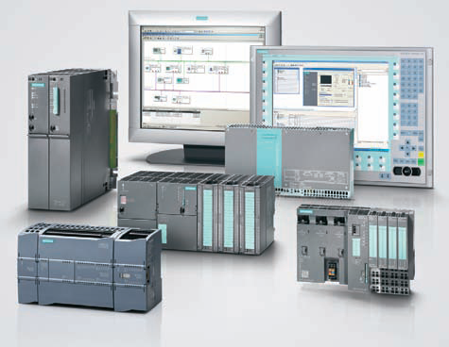
PLC Size and Application
Typical range of sizes of programmable controllers

Slide 50
PLC Size and Application
There are three major types of PLC application:
Singleended
Multitask
Control management

Slide 51
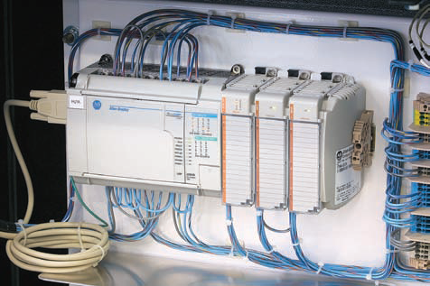
PLC Size and Application – single ended
A single ended or stand-alone PLC application involves one PLC controlling one process without communication with other computers or PLCs
Single-ended PLC application

Slide 52
PLC Size and Application - multitasking
A multitask PLC application involves one PLC controlling several processes
Adequate I/O capacity is a significant factor in this type of installation
If the PLC would be a subsystem of a larger process and would have to communicate with a central PLC or computer, provisions for a data communications network are also required

Slide 53
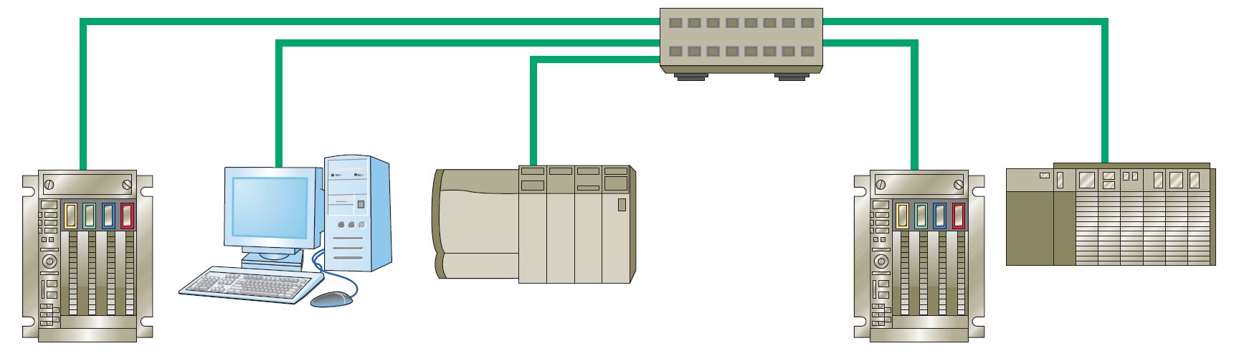
PLC Size and Application - control management
A control management PLC application involves one PLC controlling several others. This kind of application requires a large PLC processor designed to communicate with other PLCs and possibly with a computer
The control management PLC supervises several PLCs by downloading programs that tell the other PLCs what has to be done.
Control management PLC application

Slide 54
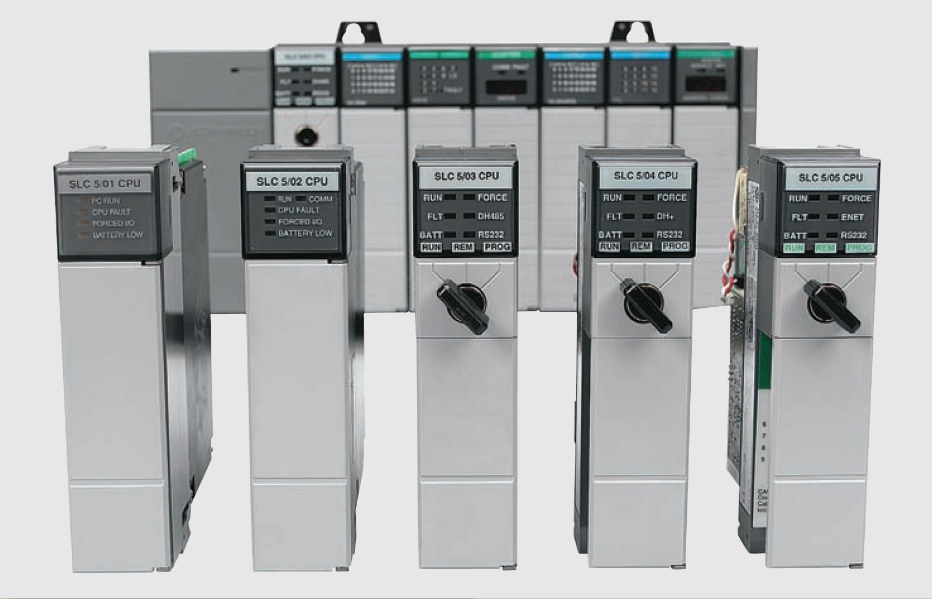
PLC Hardware Components

Slide 55
The I/O Section
The input/output (I/O) section of a PLC is the section to which all field devices are connected and provides the interface between them and the CPU
Input interface modules accept signals from the machine or process devices and convert them into signals that can be used by the controller
Output interface modules convert controller signals into external signals used to control the machine or process
A typical PLC has room for several I/O modules, allowing it to be customized for a particular application by selecting the appropriate modules
Each slot in the rack is capable of accommodating any type of I/O module

Slide 56
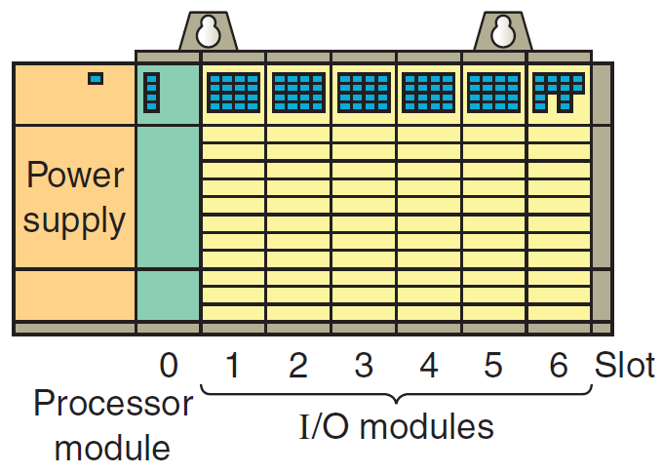
The I/O Section
Rack-based I/O section

Slide 57
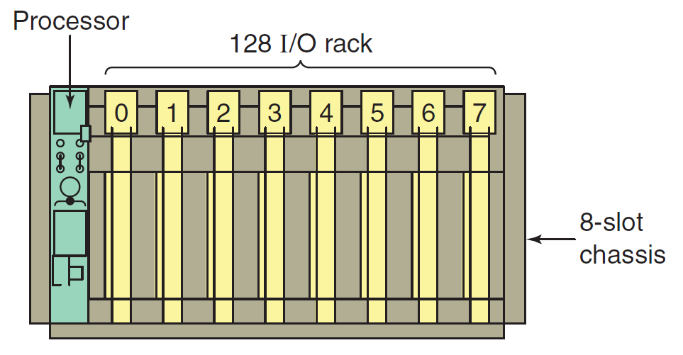
The I/O Section
A logical rack is an addressable unit consisting usually of 128 input points and 128 output points
A rack uses 8 words in the input image table file and 8 words in the output image table file
Allen-Bradley PLC chassis and rack

Slide 58
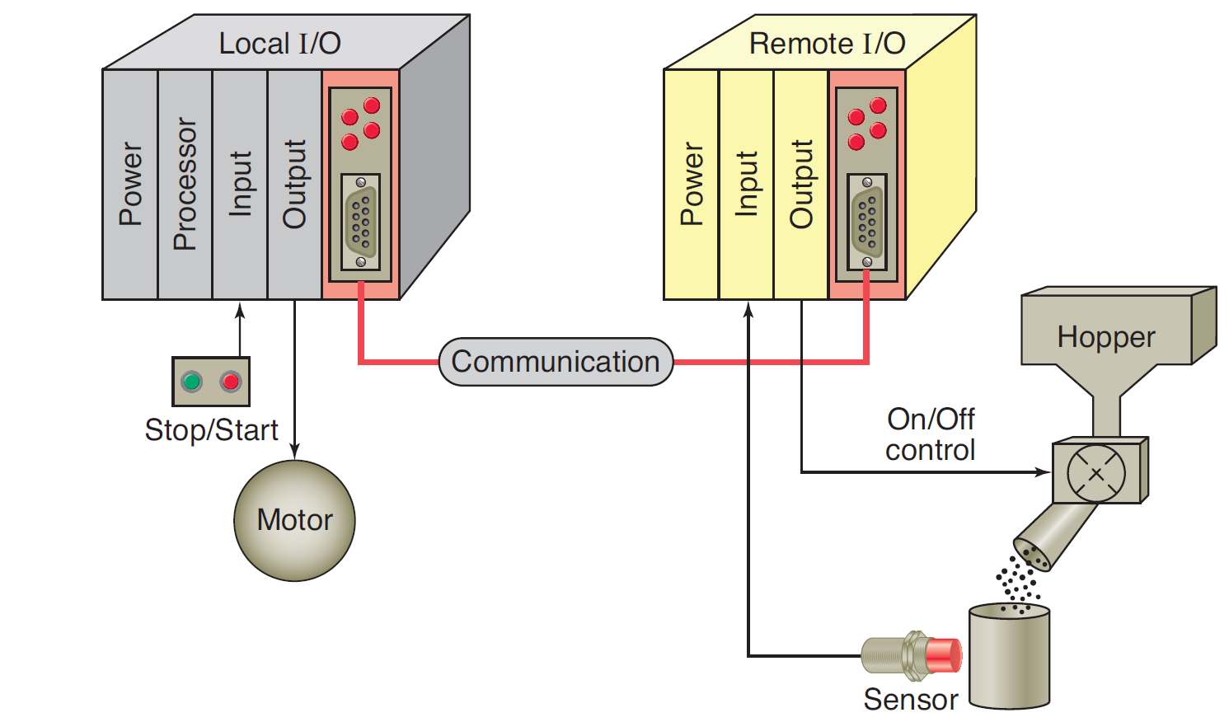
The I/O Section
One benefit of a PLC system is the ability to locate the I/O modules near the field devices and then use communication module and dedicated interface (Siemens AS interface) for communication with distributed I/O modules
Remote I/O molules

Slide 59
The I/O Section
The PLC’s memory system stores information about the status of all the inputs and outputs. To keep track of all this information, it uses a system called addressing
I/O address range depend of PLC size
In I/O address space there is possibility to address bit, byte, word and double word
EXAMPLE Siemens S7-300 addressing PII (Process image input)
Addr. ID | Parameter range | Description
I | 0.0 to 127.7 | Input bit
IB | 0 to 127 | Input byte
IW | 0 to 126 | Input word
ID | 0 to 124 | Input double word

Slide 60
The I/O Section
EXAMPLE: Siemens S7-300 addressing PIO (Process image output)
Addr. ID | Parameter range | Description
Q | 0.0 to 127.7 | Output bit
QB | 0 to 127 | Output byte
QW | 0 to 126 | Output word
QD | 0 to 124 | Output double word

Slide 61
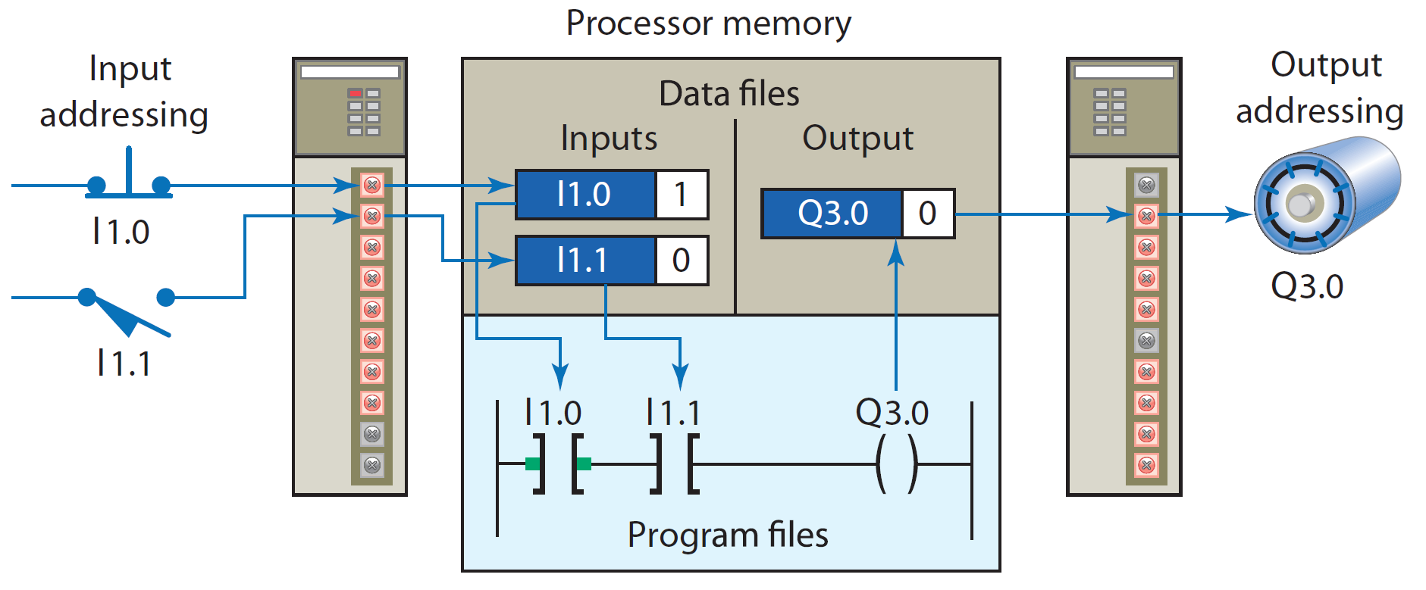
The I/O Section: bit or word addessing
In case a bit addressing only an one input bit should be addressed

Slide 62
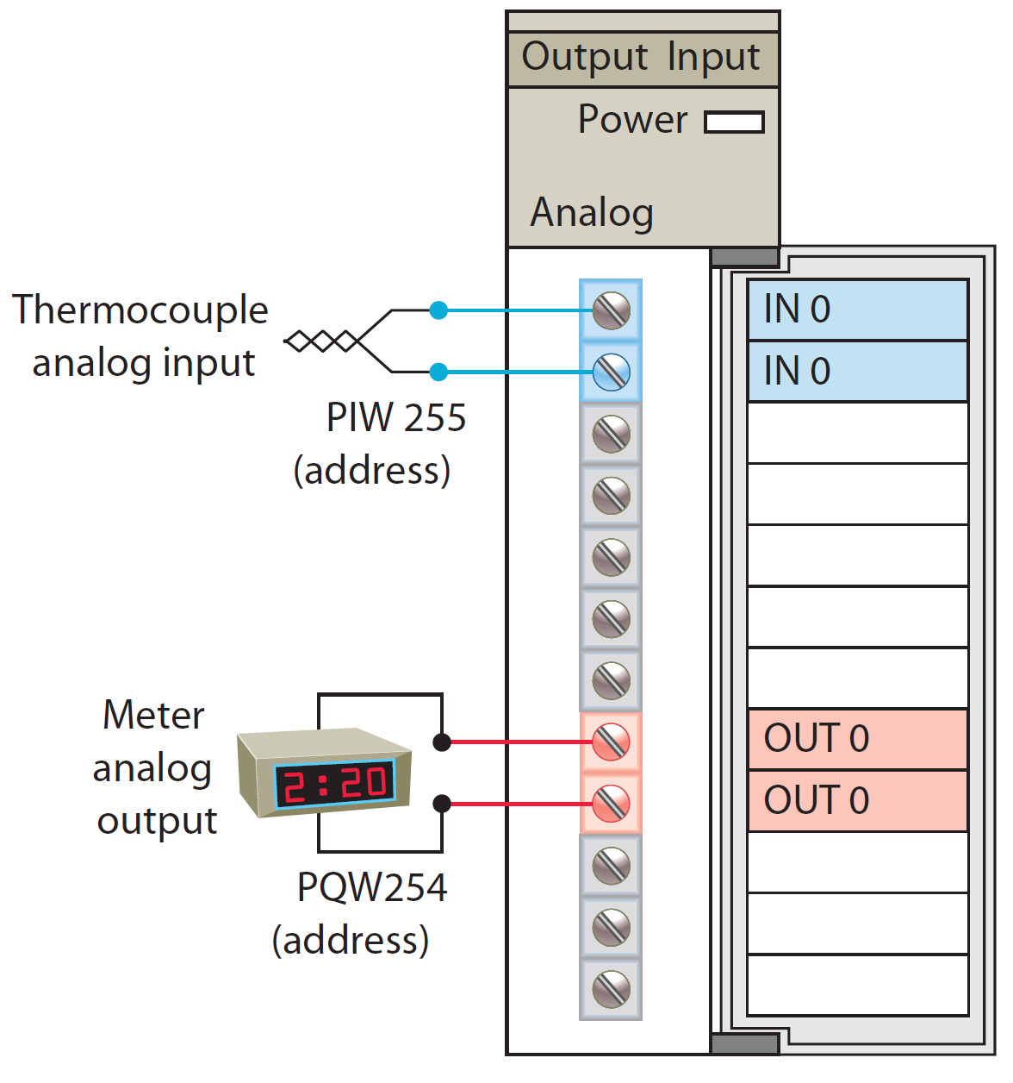
The I/O Section: bit or word addessing
In case a word addressing one word occupies two bits in memory

Slide 63
Discrete I/O Modules
The most common type of I/O interface module is the discrete type
Discrete Input modules connects field input devices of the ON/OFF nature such as selector switches, pushbuttons, and limit switches
Discrete Output modules is used for control devices such as lights, relays, solenoids, and motor starters that require simple ON/OFF switching
Each discrete I/O module is powered by some field supplied voltage source
These voltages can be of different magnitude or type, I/O modules are available at various AC and DC voltage ratings

Slide 64
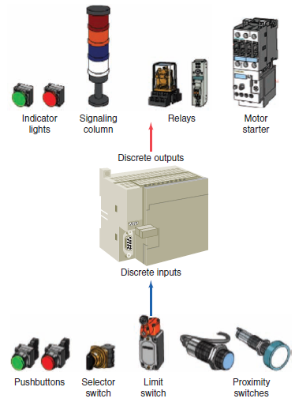
Discrete I/O Modules
What is possible to connect on I/O modules

Slide 65
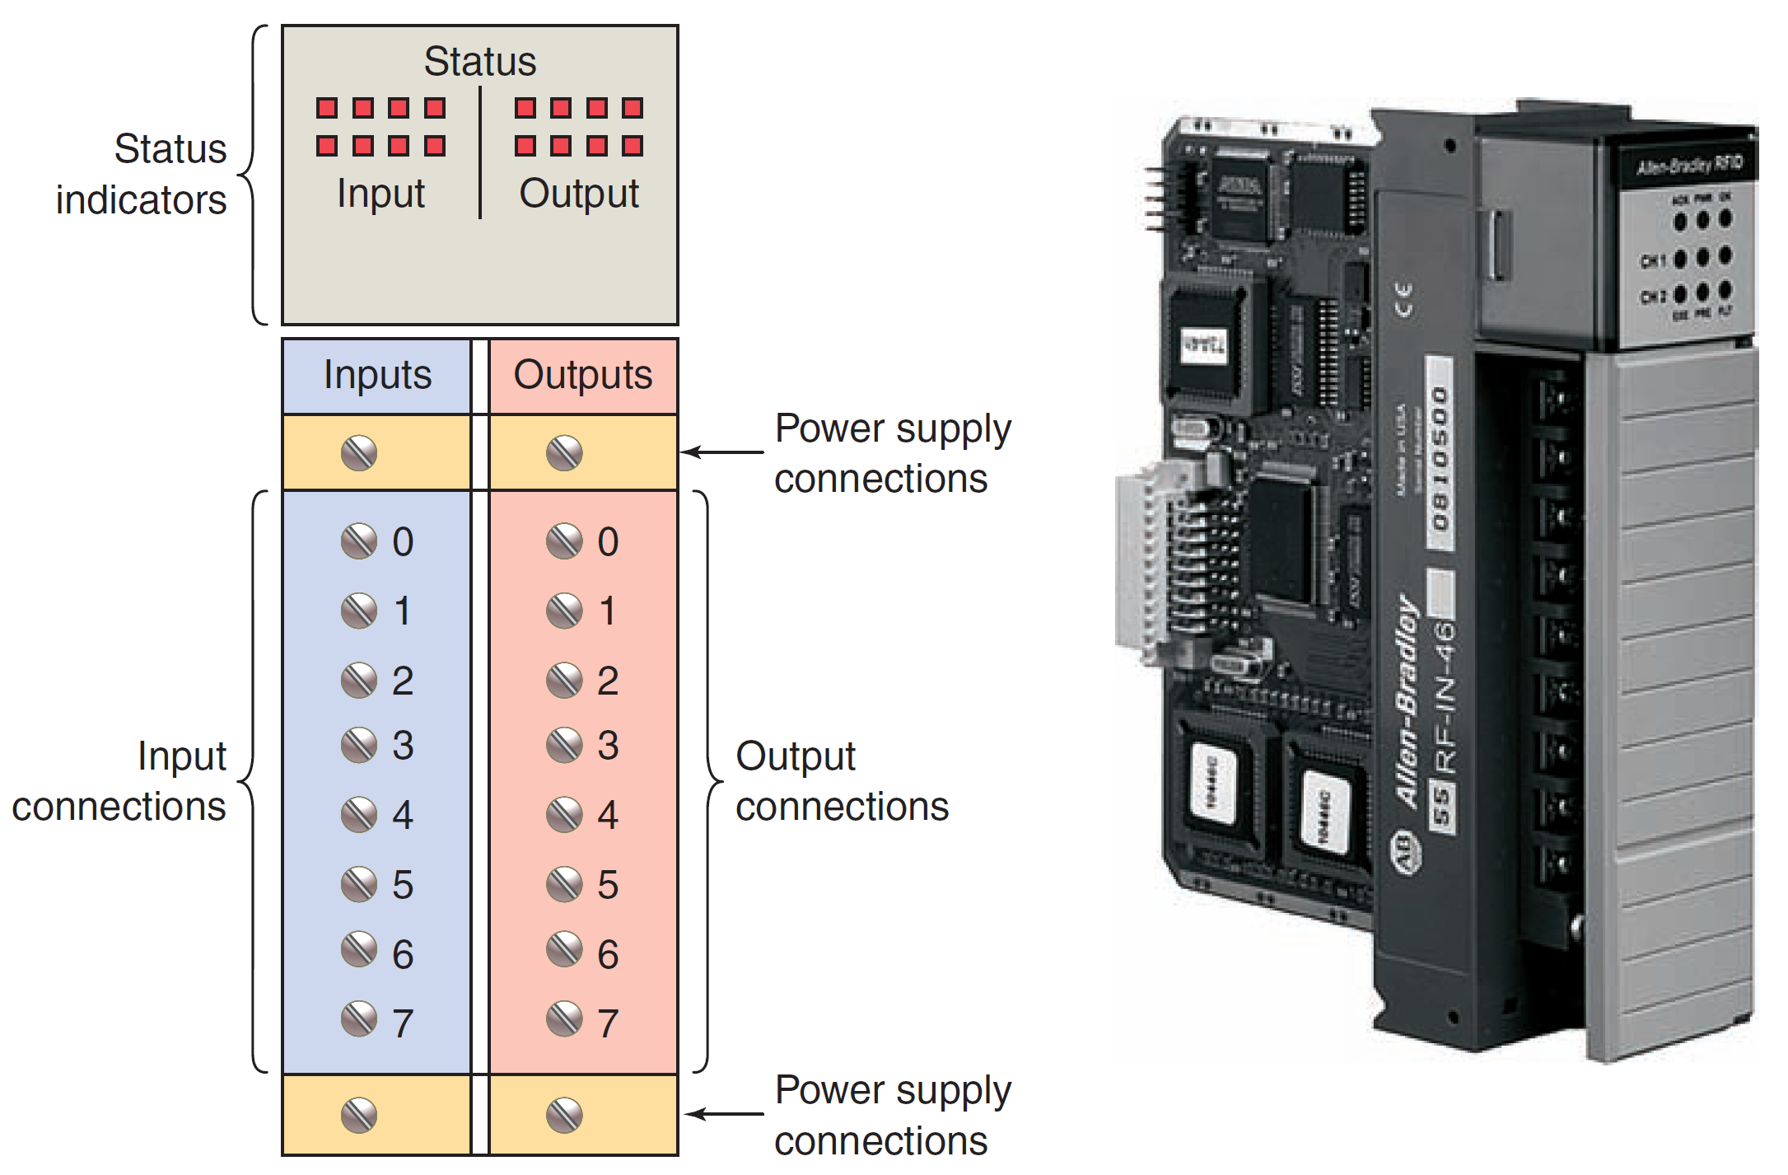
Discrete I/O Modules
Typical combination I/O module

Slide 66
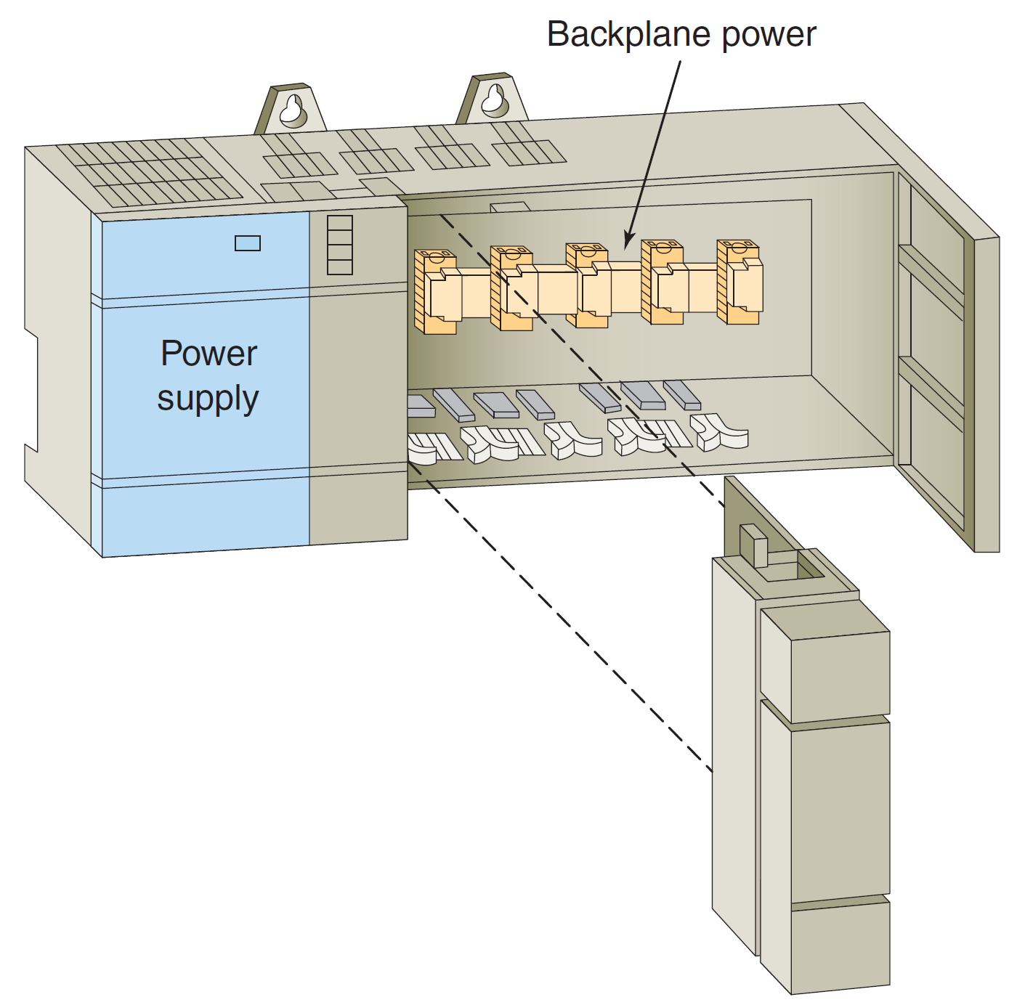
Discrete I/O Modules: supply
The modules themselves receive their voltage and current for proper operation from the backplane of the rack enclosure into which they are inserted

Slide 67
Discrete I/Onput Modules: specification
Input Interfaces | Output Interfaces
12 VAC/DC /24 V AC/DC | 12–48 V AC
48 V AC/DC | 120 V AC
120 V AC/DC | 230 V AC
230 V AC/DC | 120 V DC
5 V DC (TTL level) | 230 V DC
 | 24 V DC
 | 5 V DC (TTL level)
Common Ratings for Discrete I/O Interface Modules

Slide 68
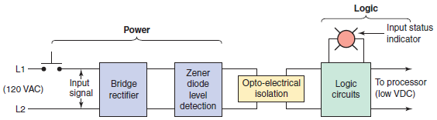
Alternating Current Discrete Input Modules
The input circuit is composed of two basic sections: the power section and the logic section
An optical isolator is used to provide electrical isolation between the field wiring and the PLC backplane internal circuitry
The input LED turns on or off, indicating the status of the input device
Discrete AC input module block diagram

Slide 69
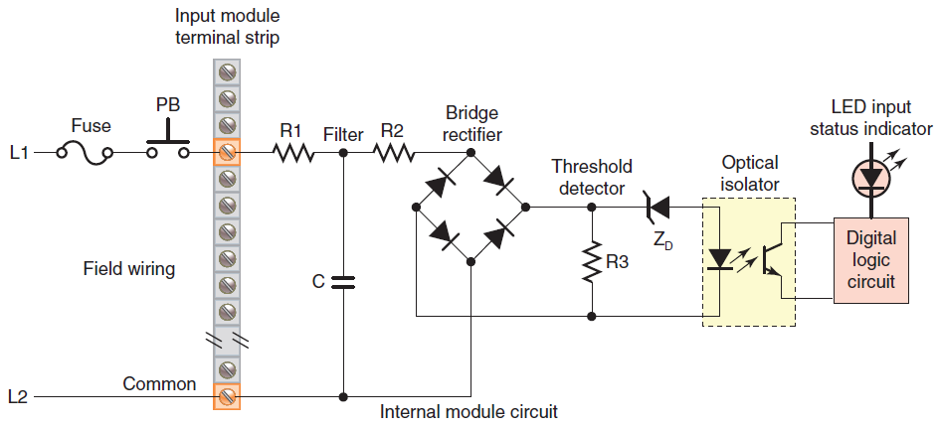
Alternating Current Discrete Input Modules
Simplified diagram for a single input of a discrete AC input module

Slide 70
Alternating Current Discrete Input Modules
The input noise filter consisting of the capacitor and resistors R1 and R2 removes false signals that are due to contact bounce or electrical interference
When the pushbutton is closed AC voltage is applied to the bridge rectifier input and a low-level DC output voltage that is applied across the LED of the optical isolator
The zener diode (ZD) voltage rating sets the minimum threshold level of input voltage that can be detected
When light from the LED strikes the phototransistor it switches into conduction state and the status of the pushbutton is latched in logic to the processor

Slide 71
Alternating Current Discrete Input Modules
The optical isolator not only separates the higher AC input voltage from the logic circuits but also prevents damage to the processor due to line voltage transients
For fault diagnosis, an input state LED indicator is on when the input pushbutton is closed. This indicator may be wired on either side of the optical isolator
An AC/DC type of input module is used for both AC and DC inputs as the input polarity does not matter

Slide 72
Discrete Input Modules
Discrete input modules perform four tasks in the PLC control system:
  Sense when a signal is received from a field device
  Convert the input signal to the correct voltage level for the particular PLC
  Isolate the PLC from fluctuations in the input signal’s voltage or current
  Send a signal to the processor indicating which sensor originated the signal

Slide 73
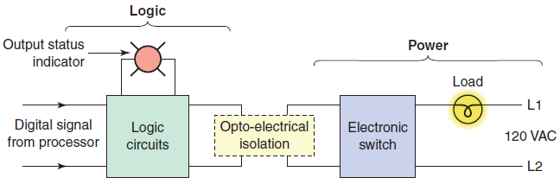
Discrete Output Modules
It is composed of two basic sections: the logic section and the power section, coupled by an opto-isolation circuit
The output interface module can be thought of as an electronic switch that turns the output load device on and off
Logic circuits determine the output status. An output LED indicates the status of the output signal
Discrete AC output module block diagram

Slide 74
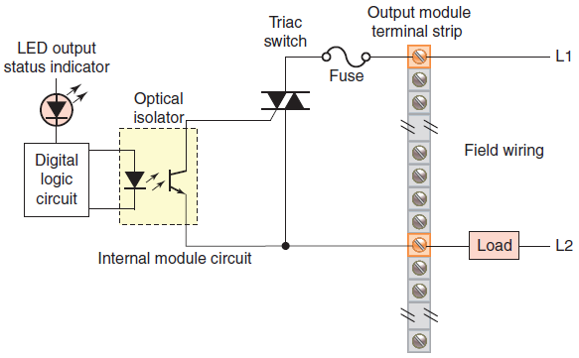
AC Discrete Output Modules
Simplified diagram for a single output of a discrete AC output module

Slide 75
Discrete Output Modules: operation
The processor sets the output status according to the (LADDER) program
When the processor calls for an output load to be energized, a voltage is applied across the LED of the opto-isolator
The LED then emits light, which switches the phototransistor into conduction state
This turn on the TRIAC as AC switch into conduction state allowing current to flow to the output load
The output interface is usually provided with LEDs that indicate the status of each output
Fuses are normally required for the output module allowing circuit to be protected
The triac cannot be used to switch a DC load

Slide 76
AC Discrete Output Modules
Simplified diagram of a discrete AC output module with triac

Slide 77
AC/DC Discrete Output Modules
Simplified diagram of a discrete AC/DC output module with relay

Slide 78
DC Discrete Output Modules
Simplified diagram of a discrete DC output module with transistor

Slide 79
Discrete Output Modules
Certain DC I/O modules specify whether the module is designed for interfacing with current-source or current-sink devices
If the module is a current-sourcing module, then the input or output device must be a current-sinking device
Conversely, if the module is specified as current-sinking, then the connected device must be current-sourcing
In general, sinking (NPN) and sourcing (PNP) are terms used to describe a current signal flow relationship between field input and output devices in a control system and their power supply.

Slide 80
Sink/Source Discrete Input Modules
Sinking and sourcing inputs

Slide 81
Sink/Source Discrete Output Modules
Sinking and sourcing outputs

Slide 82
Analog I/O Modules
The analog input interface module accepts an analog voltage or current signal from the analog field devices and convert to digital form (10 or 12 bits)
The analog output module accepts the digital value from the processor and converts it back to an analog signal
Analog input modules normally have multiple input channels that allow 4, 8, or 16 devices to be interface to the PLC
The two basic types of analog input modules are voltage sensing and current sensing
Common physical quantities measured by a PLC analog module include temperature, speed, level, flow, weight, pressure, and position

Slide 83
Analog I/O Modules
Analog input and output to a PLC

Slide 84
Analog I/O Modules
MicroLogix 4-channel analog thermocouple input module

Slide 85
Analog I/O Modules
The transition of an analog signal to digital values is accomplished by an analog-to-digital (A/D) converter
Analog voltage input modules are available in two types: unipolar and bipolar
The resolution of an analog input channel refers to the smallest change in input signal value that can be sensed and is based on the number of bits used in the digital representation

Slide 86
Analog I/O Modules
Current input signals, which are not as sensitive to noise as voltage signals, are typically not distance limited
Current sensing input modules typically accept analog data over the range of 4 mA to 20 mA, but can accommodate signal ranges of –20 mA to 120 mA.
Sensor and analog module supplied power

Slide 87
Special I/O Modules: High-speed Counter Module
Is used to provide an interface for applications requiring counter speeds that surpass the capability of the PLC ladder program
High-speed counter modules are used to count pulses from sensors, encoders, and switches that operate at very high speeds
They have the separate electronics needed to count independently of the processor
A typical count rate available is 0 to 100 kHz, which means the module would be able to count 100,000 pulses per second

Slide 88
Special I/O Modules: High-speed Counter Module
High-speed counter module for counting encoder pulses

Slide 89
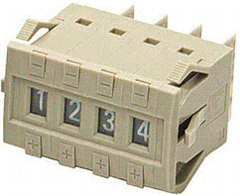
Special I/O Modules: Thumbwheel Switch Module
The thumbwheel module allows the use of thumbwheel switches for feeding information to the PLC to be used in the control program
Thumbwheel switch

Slide 90

Special I/O Modules: TTL Module
The TTL module ( Figure 2-28 ) allows the transmitting and receiving of TTL (Transistor-Transistor-Logic) signals
This module allows devices that produce TTL-level signals to communicate with the PLC’s processor
TTL module

Slide 91
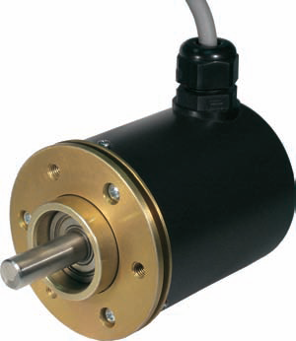
Special I/O Modules: Encoder-counter Module
An encoder-counter module allows the user to read the signal from an encoder on a real-time basis and stores this information so it can be read later by the processor
Encoder

Slide 92
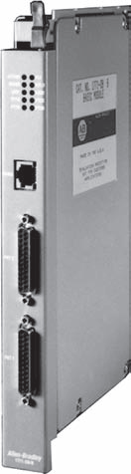
Special I/O Modules: Basic or ASCII Module
The BASIC or ASCII module runs user written BASIC and C programs. These programs are independent of the PLC processor and provide an easy, fast interface between remote foreign devices and the PLC
BASIC module

Slide 93
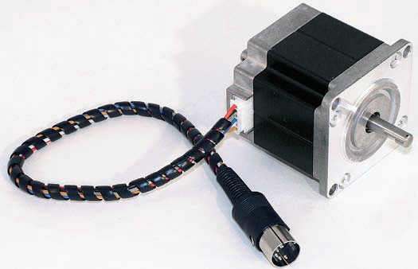
Special I/O Modules: Stepper-motor Module
The stepper-motor module provides pulse trains to a stepper-motor translator, which enables control of a stepper motor. The commands for the module are determined by the control program in the PLC
Stepper-motor

Slide 94
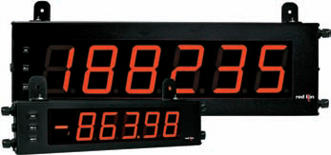
Special I/O Modules:BCD-Output Module
The BCD-output module enables a PLC to operate devices that require BCD-coded signals such as seven- segment displays
Seven-segment display

Slide 95
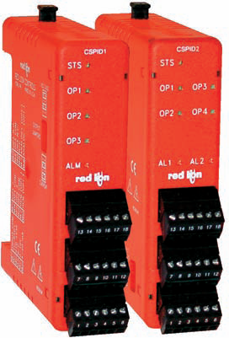
Special I/O Modules:PID Module
This module is used in process control applications that incorporate PID algorithms
An algorithm is a complex program based on mathematical calculations. A PID module allows process control to take place outside the CPU
The basic function of this module is to provide the control action required to maintain a process variable such as temperature, flow, level, or speed within set limits of a specified set point
PID module

Slide 96
Special I/O modules: Motion and Position control
Motion and position control modules are used in applications involving accurate high-speed machining and packaging operations
Intelligent position and motion control modules permit PLCs to control stepper and servo motors
PLC servo module

Slide 97
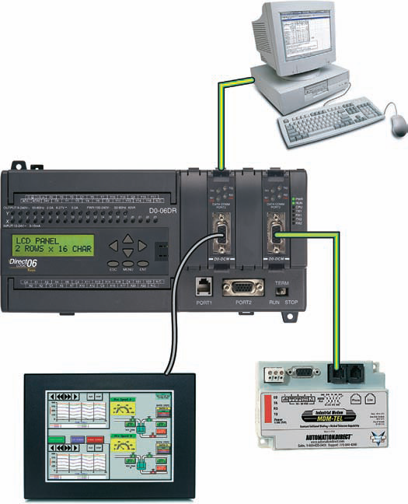
Special I/O modules: Communication Modules
Communications modules are used to establish point-to-point connections with other intelligent devices for the exchange of data
Such connections are normally established with computers, operator stations, process control systems, and other PLCs

Slide 98
I/O modules: Specification

